Slide 1

CSR Initiatives by
Aditya Birla & Group Infosys
Corporate Social Responsibility | Education • Healthcare • Livelihoods • Rural Development
A Comparative Overview of Impact-Driven Community Programs

Slide 2
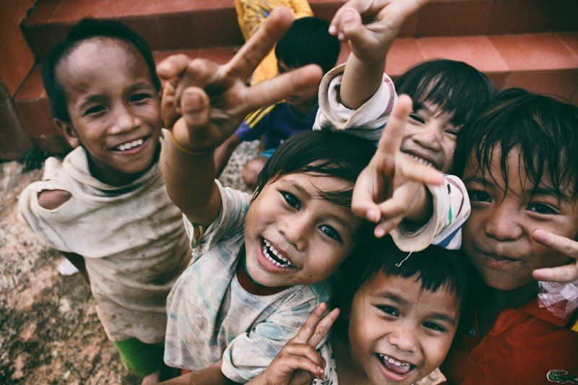
Aditya Birla Group CSR Overview
Aditya Birla Centre
Apex body chaired by Mrs. Rajashree Birla; led by Dr. Pragnya Ram with 1,200+ professionals.
Core Focus
Education, healthcare, sustainable livelihoods, infrastructure, model villages & social reform.
Approach
Reaching 9,000+ villages & 11 million people
Community-led, plant-proximate rural & tribal areas; partnership with panchayats & government.

Slide 3

Aditya Birla — Education Initiatives
56
46.5K+
32K
52
Schools across
plant locations
Students receiving
quality education
Merit scholarships
to hinterland children
Kasturba Gandhi
Balika Vidyalayas
Key Education Levers
Formal schools, balwadies & quality elementary education
Girl-child focus & solar lamps for 4.5 lakh students
Digital literacy & KHEL e-learning in remote schools
Mid-day meal kitchens supporting tens of thousands
Aditya Birla Scholarships for higher studies

Slide 4

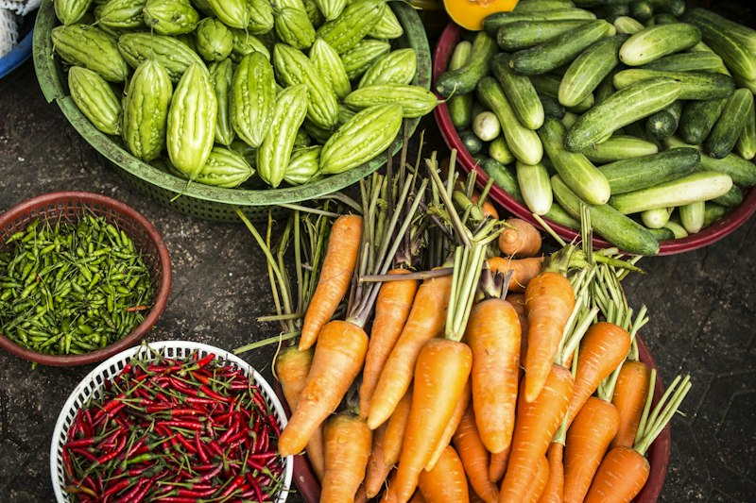
Aditya Birla — Healthcare & Sustainable Livelihoods
Healthcare Reach
Sustainable Livelihoods
18+ hospitals & primary health centres
Mother & child care, immunization, malnutrition
Eye camps, cancer care & TB detection
Mobile health units & ambulance services
1M+ people reached annually through health projects
1 lakh+ people trained in skill sets
5,000 Self-Help Groups empowering 50,000 women
2 lakh farmers in agro-based training
Multi-skill training centres (Raipur, Udaipur…)
Watershed & water harvesting across villages

Slide 5

Aditya Birla — Model Villages & Holistic Development
Model Village Vision
Self-reliance across education, healthcare, infrastructure, agriculture, watershed management and sustainable livelihoods. Village committees eventually take full ownership.
128+ model villages transformed across 22 states
Transforming villages into self-reliant communities
Group-wide Reach (approx.)
11 million people • 9,000 villages • Education & health for 6 lakh+ each • Model villages for 5 lakh+

Slide 6
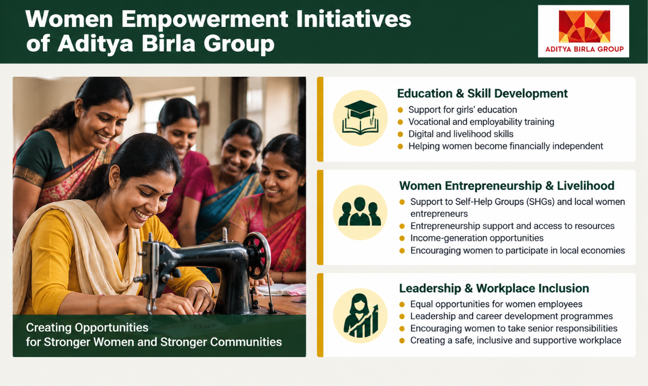

Slide 7
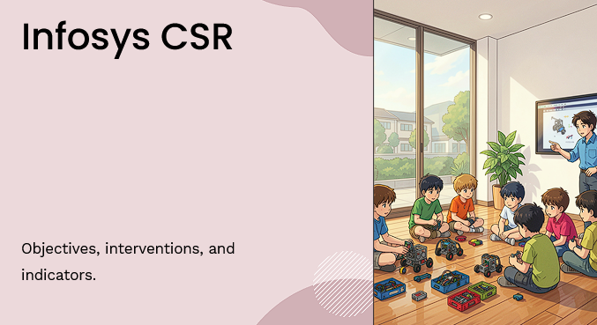

Slide 8
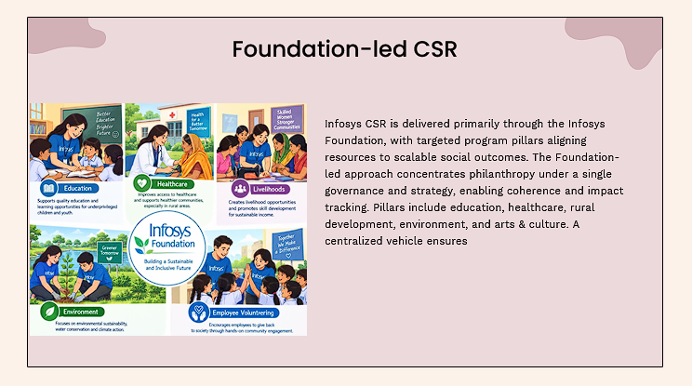

Slide 9
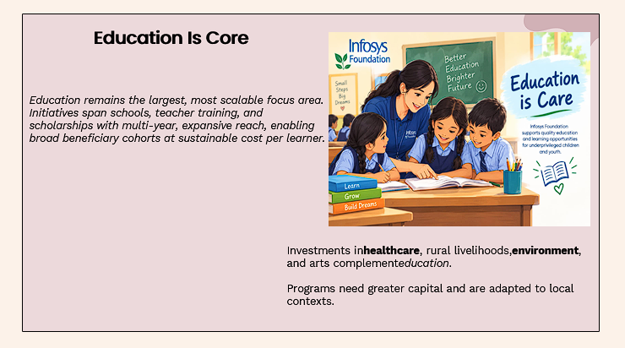

Slide 10
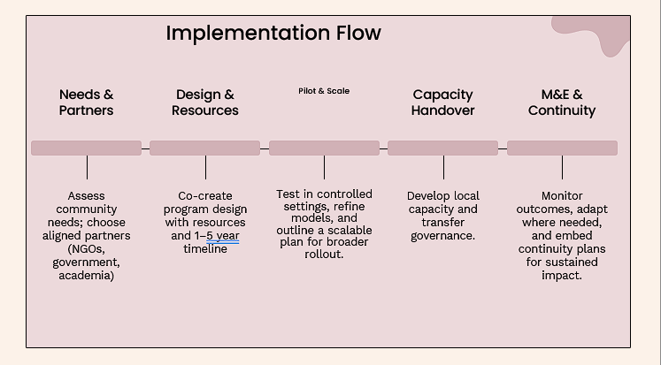

Slide 11
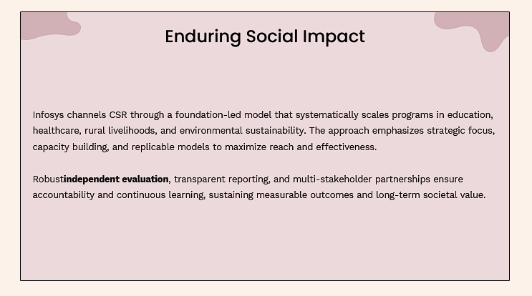

Slide 12
Shared Themes & Distinct Strengths
Focus Area
Infosys
Aditya Birla Group
Education & Skilling
Springboard, STEM labs, digital literacy, scholarships
56 schools, girl-child focus, mid-day meals, scholarships
Healthcare
Cornea mission, SightConnect AI, mental health, hospitals
Hospitals, mother-child care, camps, cancer & TB support
Livelihoods
Job-oriented skilling, women training centres
SHGs, vocational centres, farmer training, multi-skill hubs
Rural / Environment
Agroforestry, rural infra, disaster relief
Model villages, watershed, sanitation, plant-proximate
People Power
84k+ employee volunteers, Gracious Giving
1,200+ CSR professionals + community field force

Slide 13

Key Takeaways
Long-term commitment
1
Both began CSR decades before legal mandates — Foundation (1996) & Birla legacy of community care.
Technology + Grassroots
2
Infosys leverages AI & digital platforms; Birla emphasizes deep rural immersion and model villages.
People as force multipliers
3
Employee volunteering (Infosys) and professional field force (Birla) amplify reach and ownership.
Teamwork & collective impact drive lasting change
Aligned with SDGs
4
Education, health, gender, livelihoods and environment — clear mapping to UN Sustainable Development Goals.

Slide 14
