Slide 1
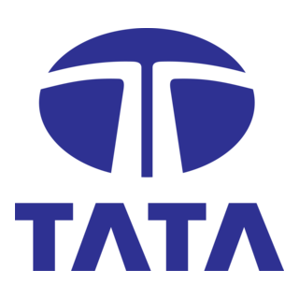
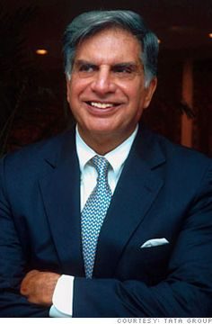
CORPORATE GOVERNANCE STUDY
Tata Group
Governance, Values & Legacy of India’s Most Trusted Business House
Founded 1868 • Mumbai, India • 100+ Countries

Slide 2
BACKGROUND
About the Tata Group
1868
100+
Year Founded
Countries served
The Tata Group is one of India’s oldest and largest multinational business conglomerates, headquartered in Mumbai. Operating across ten sectors — from steel and automobiles to information technology and hospitality — the Group is distinguished by a governance model in which the promoter holding company, Tata Sons, is itself majority-owned by philanthropic Tata Trusts. This structure ties commercial success directly to public good.
30
10
Public-listed companies
Business sectors
~66%
1M+
Of Tata Sons held by Tata Trusts
Employees group-wide
TATA GROUP — CORPORATE GOVERNANCE
3

Slide 3
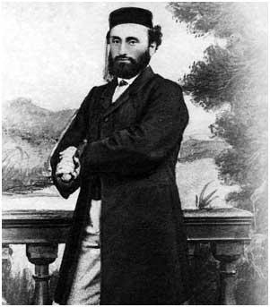
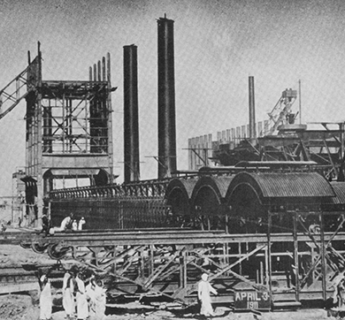
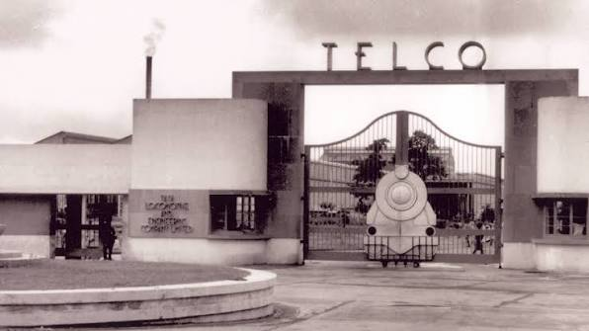
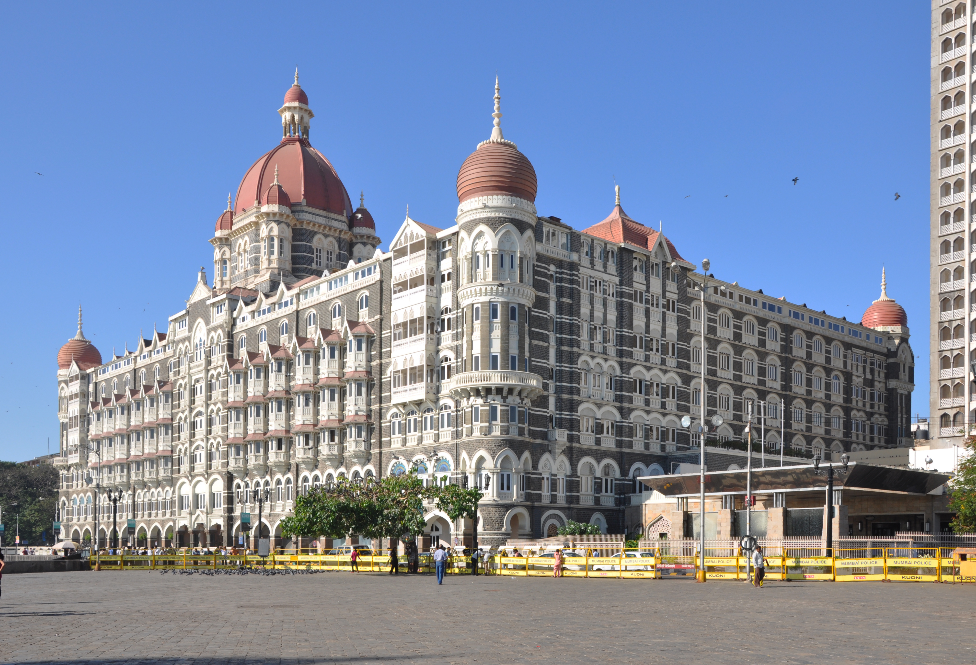
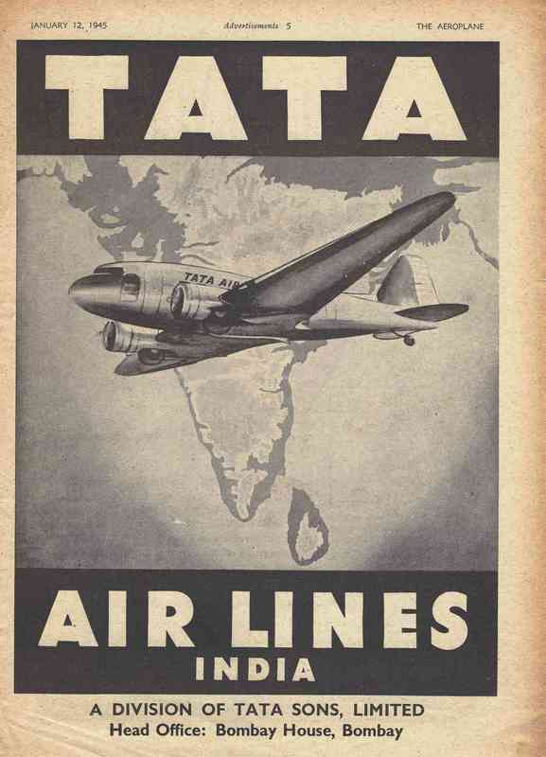
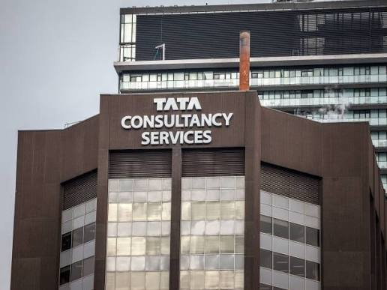
ORIGINS
History & Founding Background
1868
1907
1945
Jamsetji Nusserwanji Tata starts a trading company in Bombay — the seed of the Group.
Tata Iron & Steel Co. (now Tata Steel) — Asia’s first integrated steel plant.
Tata Engineering (TELCO) founded — today’s Tata Motors.
1902
1932
1968
The Taj Mahal Palace opens in Mumbai, India’s first luxury hotel.
Tata Airlines launched (later nationalised into Air India, 1953).
Tata Consultancy Services (TCS) founded, pioneering Indian IT services.
TATA GROUP — CORPORATE GOVERNANCE
4

Slide 4
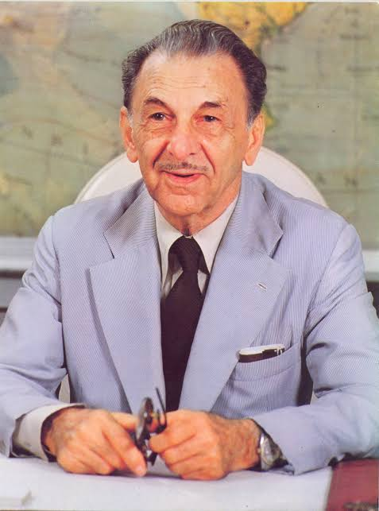
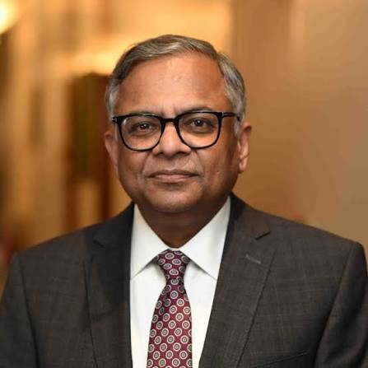
LEADERSHIP
A Legacy of Governance
Jamsetji N. Tata
JRD Tata
Ratan N. Tata
N. Chandrasekaran
Founder • 1868–1904
Chairman • 1938–1991
Chairman • 1991–2012, 2016–17
Chairman • 2017–present
Laid the founding vision: steel, power, education and hospitality for a self-reliant India.
Longest-serving Chairman; expanded the Group into aviation, chemicals and more.
Modernised and globalised the Group — Tetley, Corus, Jaguar Land Rover.
First non-Parsi, non-family Chairman; driving digital & sustainability transformation.
TATA GROUP — CORPORATE GOVERNANCE
5

Slide 5
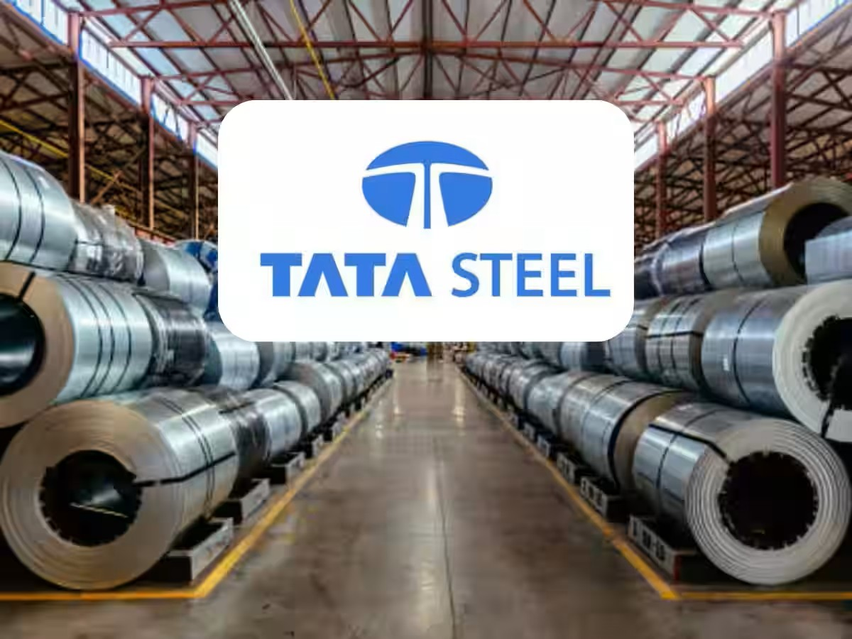
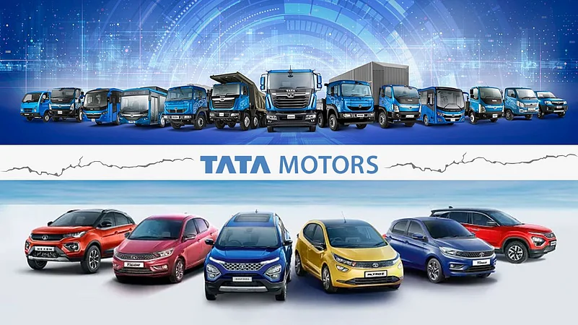
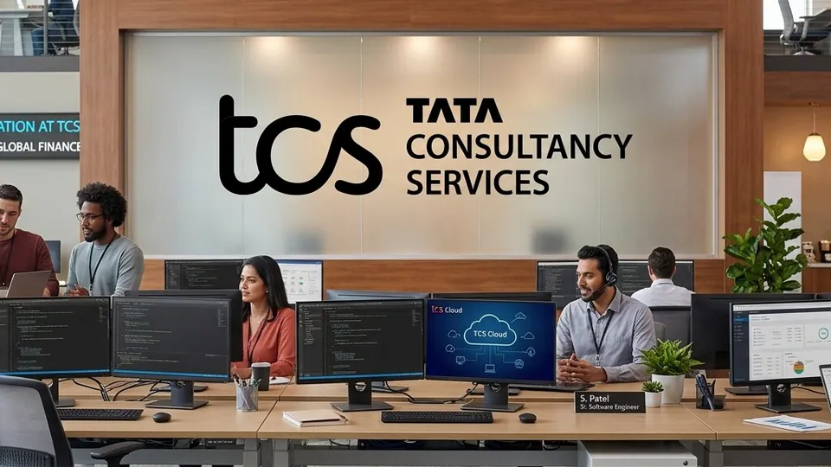

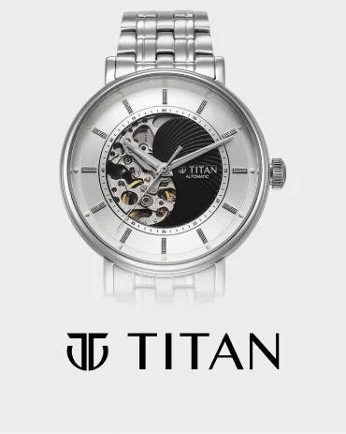
Ownership & Governance Structure
The Group’s defining governance feature: Tata Sons, the principal holding company, is majority-owned by philanthropic Tata Trusts. Roughly two-thirds of dividends earned by Tata Sons flow into trusts that fund healthcare, education, arts and rural development — embedding public purpose at the very top of the corporate structure.
Tata Trusts
~66% ownership • Philanthropy
Tata Sons (Pvt. Ltd.)
Principal holding company
• Board of Directors
Tata Steel
Tata Motors
TCS
Tata Power
Titan
Indian Hotels
TATA GROUP — CORPORATE GOVERNANCE
6
...and 25+ other operating companies across the Group

Slide 6
RULES OF CONDUCT
Governance Policies
✓
Tata Code of Conduct — the ethical charter binding every employee and company.
✓
Anti-Bribery & Anti-Corruption Policy aligned to global standards.
✓
Whistleblower / Vigil Mechanism Policy for reporting concerns safely.
✓
Prevention of Sexual Harassment (POSH) Policy.
✓
CSR Policy — statutory 2% of average net profit directed to social programmes.
✓
Risk Management Policy covering financial, cyber & reputational risk.
✓
Related Party Transaction Policy ensuring arm’s-length group dealings.
✓
Board Diversity & Data Privacy policies across listed entities.
TATA GROUP — CORPORATE GOVERNANCE
13

Slide 7
OVERSIGHT
Board & Governance Framework
✓
Board Composition
✓
Nomination & Remuneration Committee
Tata Sons’ board blends family-legacy trustees, professional directors and independent members.
Governs director appointments, succession planning and executive compensation.
Independent Directors
CSR Committee
✓
Listed Group companies maintain a majority of independent directors on their boards, per SEBI norms.
✓
Mandated under the Companies Act, 2013 to monitor social-impact spending and programmes.
Audit Committee
Risk Management Committee
✓
✓
Oversees financial reporting, internal controls and statutory/internal audit findings.
Reviews enterprise risk — financial, cyber, geopolitical and reputational.
TATA GROUP — CORPORATE GOVERNANCE
8

Slide 8
PORTFOLIO
Companies of the Tata Group
Tata Consultancy Services
Tata Motors
Tata Steel
Tata Power
Information Technology
Automotive
Steel & Metals
Energy
Titan Company
Tata Chemicals
Indian Hotels (Taj)
Tata Communications
Consumer / Lifestyle
Chemicals
Hospitality
Telecom
Air India
Tata Capital
Voltas
Tata Consumer Products
Aviation
Financial Services
Consumer Durables
FMCG & Beverages
TATA GROUP — CORPORATE GOVERNANCE
9

Slide 9
RESPONSE
Lessons & Governance Reforms
The Mistry episode became a turning point for how the Group formalises power-sharing between Tata Trusts and Tata Sons. Since 2017, the Group has visibly strengthened structural safeguards:
✓
Clearer Articles of Association defining Trusts’ nominee-director rights on the Tata Sons board.
✓
Tighter oversight of related-party transactions between Trusts, Sons and operating companies.
✓
A more structured, board-led CEO & Chairman succession-planning process.
✓
Improved crisis communication and investor-relations protocols during disputes.
✓
Reinforced independent-director representation across listed operating companies.
✓
Greater transparency in reporting the Trusts’ philanthropic use of dividend income.
TATA GROUP — CORPORATE GOVERNANCE
17

Slide 10
FOUNDATION
Values of the Tata Group
Five values anchor the Tata Code of Conduct across every Group company.
I
U
R
E
P
Integrity
Unity
Responsibility
Excellence
Pioneering
Acting ethically and fairly in all dealings, upholding what is right.
Building strong relationships and working as one Tata, across geographies.
Being accountable to society and the environment, not only shareholders.
Constantly pursuing the highest standards in quality and performance.
Being bold and agile, embracing new ideas ahead of the market.
TATA GROUP — CORPORATE GOVERNANCE
7

Slide 11
RECOGNITION
Awards & Recognition
★
World’s Most Ethical Companies
★
Padma Vibhushan (2008)
★
Most Valuable Indian Brand
TCS named repeatedly by Ethisphere Institute.
India’s 2nd highest civilian honour, awarded to Ratan N. Tata.
Tata ranked India’s most valuable brand by Brand Finance.
★
Golden Peacock Awards
★
Sustainability Leadership
★
Great Place to Work®
Recognising Group companies’ CSR & governance excellence.
Tata Steel & Tata Power recognised for climate & safety performance.
Multiple Tata companies certified for workplace culture.
TATA GROUP — CORPORATE GOVERNANCE
12

Slide 12
SETBACKS
Challenges, Drawbacks & Failures
!
Cyrus Mistry Ouster (2016–21)
!
Tata Nano
Abrupt removal of Tata Sons’ Chairman triggered a public boardroom battle and years of litigation, testing governance credibility before the Supreme Court upheld Tata Sons.
The “world’s cheapest car” struggled commercially despite engineering ambition; the Singur, West Bengal plant was abandoned after land protests, forcing a costly relocation to Gujarat.
!
Corus Steel Acquisition (2007)
!
Tata–NTT DoCoMo Dispute
The landmark UK/European buyout later required heavy asset write-downs amid the 2008 financial crisis and a prolonged European steel downturn, including UK job cuts at Port Talbot.
A telecom joint venture unwound in an arbitration dispute over an exit clause, costing Tata Sons roughly $1.18 billion in a 2017 settlement.
TATA GROUP — CORPORATE GOVERNANCE
16

Slide 13
CLOSING THOUGHTS
Conclusion
✓
Tata Group’s governance is unique: ownership is anchored in philanthropy, not just profit.
✓
Values — Integrity, Unity, Responsibility, Excellence, Pioneering — remain the operating compass.
✓
The Group has weathered real governance stress-tests (Mistry episode) and emerged with reforms.
✓
TCS and other flagships prove that ethics and world-class performance can co-exist.
✓
Ongoing bets — semiconductors, EVs, Air India, digital — will define the next governance chapter.
TATA GROUP — CORPORATE GOVERNANCE
18

Slide 14
Thank You
Questions & Discussion

