Slide 1

Group Presentation on -
Articles of the Indian Constitution Related to Education from Gender Equality Perspective
Presented by Group- 18
Mehboob Alom
Satendar Chauhan
Angring Rongpipi

Slide 2
Introduction
Education is the process of imparting or acquiring general knowledge, skills and developing the powers of reasoning and judgement.
  Education and Gender Equality are two pillars of national development, and both are strongly protected by the Indian Constitution.
  The Constitution provide Articles that aims to prevent gender discrimination in education.
  These Articles support equal access to education for girls and boys and also transgender.

Slide 3

Gender Equality in Education
Gender Equality in Education means that both boys and girls, including transgender children, should get equal access, equal opportunities, equal treatment and equal benefits in education.
It also means that no child should be denied admissions, facilities, or participation in school activities just because of their gender.

Slide 4

Articles of Indian Constitution Related to Education from a Gender Equality Perspective
Article 14
    This article state that “The state shall not deny to any person equality before the law or the equal protection of the laws within the territory of India”
Article 15
    This article state that “The State shall not discriminate against any citizen on grounds only of religion, race, caste, sex, place, of birth or any of them”

Slide 5
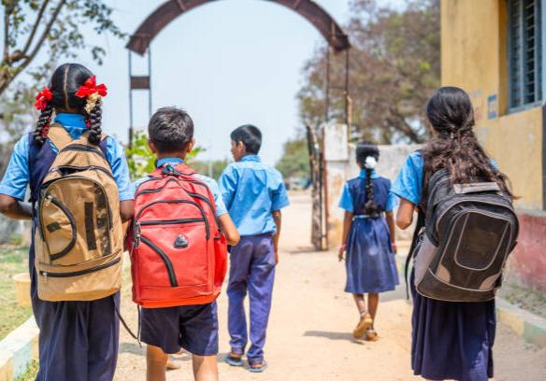
Article 15(3)
    This article state that, “Nothing in this article shall prevent the state from making any special provision for women and children”
Article 21A
    This article state that, “The State shall provide free and compulsory education to all children of the age of 6-14 years in such a manner as the state may, by law determine”

Slide 6

Article 45
    This article state that, “The State shall endeavour to provide early childhood care and education for all children until they complete the age of 6 years”
Article 51A(k)
    This article state that, “It should be the duty of every citizen of India who is a parent or guardian to provide opportunities for education to his child or as the case may be ward, between the age of six and fourteen years”

Slide 7
Conclusion
The Indian Constitution is the strongest foundation for Gender Equality in Education.
The Articles of the Indian Constitution related to education ensure that education is not only a privilege to one gender, but a right of every child whether boy, girl or transgender.
The Constitution not only prohibits discrimination but also allows special provision to empower girls who were denied education.
Therefore, Gender Equality will be truly achieved only when these Constitutional Articles are fully implemented in every family, schools and classrooms.

Slide 8
Thank You

