Slide 1
FYUG 7th Sem and PG 1st Sem 2026
Course Title :Higher Education
Course Code :DSC-EDU-402
Nature of the Course :Major
UNIT–1: HIGHER EDUCATION IN INDIA

Slide 2
UNIT–1: HIGHER EDUCATION IN INDIA
STRUCTURE OF HIGHER EDUCATION
Prepared as Study Material / Classroom Presentation
For FYUG 7th Sem and PG 1st Sem-
1st October 2026
Prepared and uploaded by
Dr. N I Barbhuyan
Assistant Professor & HoD, Education
Rabindranath Thakur Vishwavidyalaya (RTV), SS Campus, Hojai – 782436
Rabindranath Thakur Vishwavidyalaya | Department of Education

Slide 3

Defining the Higher Education Structure
Systematic organization of institutions, programmes, levels, and regulatory bodies beyond secondary school.
Multi-Level Architecture
Spans diplomas, undergraduate, postgraduate, doctoral, and post—doctoral studies.
Diverse Institutional Ecosystem
Comprises public, private, autonomous, and specialized national institutes.
Flexible Credit Pathways
Evolving toward multidisciplinary choice and credit transfer mechanisms.

Slide 4




Levels of Higher Education
ACADEM IC HI ERARC HY
Sequential academic progression from skill training to original research.
Diploma & Cert.
Short—term vocational skill specialization.
Undergraduate
3—4 year foundational Bachelor's degree.
Postgraduate
l—2year advanced Master's specialization.
Post-Doctoral
Advanced independent research post—doctorate.
Doctoral (Ph.D.)
3—5 year original thesis research.

Slide 5
Types of Higher Educational Institutions
I NSTIT UTIONAL LANDSCAPE
Tripartite categorization of Indian higher education centers.
jut Universities
Colleges
Government: Fully state funded Govt-Aided: Partial state grant Self- Financing: Private capital Autonomous: Curricular freedom Constituent: Direct university unit
0 Specialized Institutes
Technical: Engineering focus Medical: Healthcare educ ation Teacher Education: Pedagogic al Agri & Vet: Rural science
Law & Management: Professional
Central: Parliament established State: Provincial legislation Private: Sponsoring bodies Deemed: Academic status
INI: National Importance

Slide 6



Major Components & Functions
CORE PILLARS
Primary functional domains defining institutional objectives.
Teaching & Learning
Knowledge and skill development.
Research & Innovation Creation of original knowledge.
Skill Development
Employability and entrepreneurship.
Extension & Community
Connecting higher education to society.
¿¿¿ Internationalization
*”“ Global academic collaboration.
Lifelong Learning Continuing adult education.

Slide 7



Regulatory & Quality Framework
GOV ERNANC E ARC HIT EC TURE
Key statutory and accrediting oversight mechanisms.
General Regulation
UGC: Coordination, standards, and funding distribution across universities.
Professional Councils
Statutory bodies governing domain standards (AICTE, NMC, BCI, NCTE).
Quality Assurance
Accreditation agencies evaluating institutional excellence (NAAC, NBA).

Slide 8
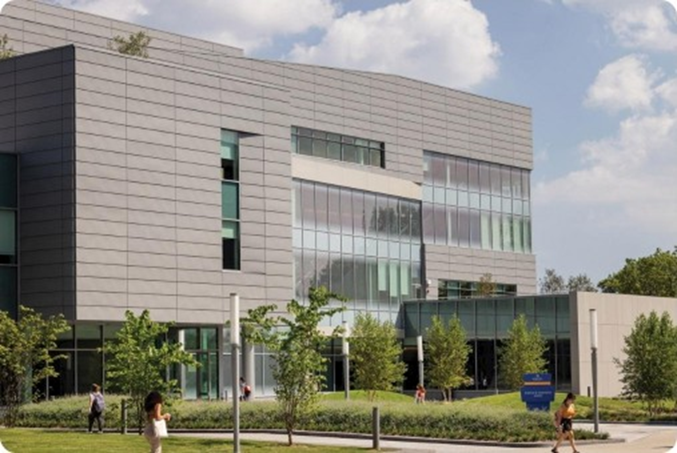

Slide 9
Higher Education under NEP 2020
POL I CY PARADI GM SHIFT
Modernization towards hexible, multidisciplinary, and credit—based learning
Multidisciplinary HEIs
Transitioning single—stream colleges into large multidisciplinary
universities.
Multiple Entry & Exit(ME-ME)
Flexible exits with Certificate, Diploma, or Degree credits.
Academic Bank of Credits (ABC)
Digital credit repository facilitating seamless institution transfer.

Slide 10
Three-Tier Degree Structure (NEP 2020)
NEP FRAM EWORK
Reconfigured duration, qualifications, and exit awards.
LEVEL 1
LEVEL 2
LEVEL 3
Undergraduate
3-4 Years Duration
•lYear:Certificate
2 Years: Diploma
3 Years: Bachelor's Degree
4 Years: Degree with Research
Postgraduate
1-2 Years Duration
l Year PG for 4—yr UG grads
2 Year PG for 3—yr UG grads
Advanced research orientation
Professional specialization
Doctoral (Ph.D.)
3—5 Years Duration
Direct entry post 4—yr UG
Original thesis contribution
M.Phil. programme discontinued
High research rigour focus

Slide 11
Administrative & Resource Challenges
C RITICAL BOTT LENEC KS • PART 1
Operational and resource constraints in Indian higher education.
1. Administrative Level
Bureaucratic delays, complex policy execution, and regulatory overlap.
2. Institutional Level
Leadership vacuums and operational management hurdles.
3. Infrastructure & Technology
Gaps in modern laboratories, libraries, and digital classrooms.
4-ó. HR, Material & Financial
Faculty shortages, outdated materials, and constrained research funding.

Slide 12
Quality, Affiliation & Market Alignment
CRITICAL BOTT LENEC KS • PART 2
Structural conflicts between expansion, standards, and global standing.
7. Access vs. Quality
Rapid enrollment expansion risks diluting foundational
academicquality.
8. Affiliation Burden
Affiliating universities overwhelmed managing hundreds of colleges.
9. Employability Gap
Skill mismatches and uneven integration of practical vocational training.
IO. Global Standing
Low representation of Indian institutions in top global rankings.

Slide 13
Dear Students, Feel free to ask questions relating to the Topics
Warm welcome for Open Discussion
Academic Note
This presentation is based on the study material prepared for students of Rabindranath Thakur Vishwavidyalaya, SS Campus, Hojai.
For classroom/academic use.
Commercial use or other use is not permitted without prior permission of the author.
Dr. N I Barbhuyan | Department of Education | RTV, SS Campus, Hojai

Slide 14
THANK YOU DEAR STUDENTS
Academic Note
This presentation is based on the study material prepared for students of Rabindranath Thakur Vishwavidyalaya, SS Campus, Hojai.
For classroom/academic use.
Commercial use or other use is not permitted without prior permission of the author.
Dr. N I Barbhuyan | Department of Education | RTV, SS Campus, Hojai

