Slide 1
Session On
Educational Technology and Teaching Methods
MICRO TEACHING AND ITS NEEDS IN EDUCATION
Presented By
Dr N I Barbhuyan, Department of Education, RTV, Hojai-Assam

Slide 2
MICRO TEACHING AND ITS NEEDS IN EDUCATION
INTRODUCTION
The quality of education largely depends upon quality of teachers. The quality teachers can present quality teaching. The art of teaching does not merely involve a simple transfer of knowledge from one to other. It is a complex process that facilitates and influences the process of learning. Quality of a teacher is estimated on how much the students understand from his/her teaching. The classrooms cannot be used as a learning platform for acquiring primary teaching skills. The pedagogic skill for teaching can be acquired only through more structured and cheaper faculty training techniques.

Slide 3
MICRO TEACHING AND ITS NEEDS IN EDUCATION
GENESIS OF MICRO-TEACHING
Dwight W. Allen and his co-workers first adopted the concept of Micro-teaching in 1961 in Stanford University.

Slide 4
MICRO TEACHING AND ITS NEEDS IN EDUCATION
SIGNIFICANCE IN THE PRESENT CONTEXT OF EDUCATION
A large section of teachers trainee in our society come forward for B.Ed. Degree with an intention to receive degrees only. Until and unless they change their paradigm of learning it is difficult for the part of educational institutions to give quality teachers training. We must redefine systems, approaches and outcome. Teachers must be capable of bringing drive and mobility in Teaching-Learning & Research. That’s why educationists find it extremely significant.

Slide 5
MICRO TEACHING AND ITS NEEDS IN EDUCATION
WHY MICRO TEACHING?
FOR GENERATING IDEAS
FOR INNOVATIVE TEACHING
FOR DEVELOPING METHODOLOGY
TRAIN UP TRAINEE TEACHERS AND PRESERVICE TEACHERS
TO ENHANCE TEACHING EFFICIENCY
TO DEVELOP TEACHING STRATEGIES AND SKILLS

Slide 6
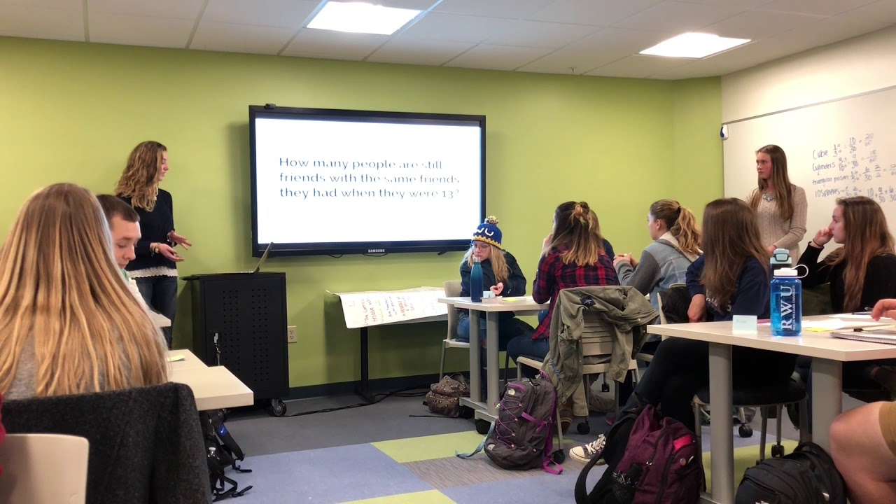
MICRO TEACHING AND ITS NEEDS IN EDUCATION
WHAT IS MICRO TEACHING?
It is an innovative process of scale –down teaching practice held in the presence of supervisor(s) experts in a controlled situation with reasonably small group of students for a short period of time. This is intended to enhance the skills of teachers by focusing on a specific skill at one time, this approach has proved to be beneficial.

Slide 7
THE BASICS OF MICRO-TEACHING
PLAN
RE-TEACH
RE-PLAN
OBSERVE
TEACH
FEEDBACK
RE-OBSERVE

Slide 8
Cycles of micro teaching
MICRO TEACHING
1.
Planning
the session
6.
Getting more feedback
2.
Teaching the students
3.
Getting feedback from the supervisors
4.
Re-planning after the feedback
5.
Re-teaching

Slide 9
MICRO TEACHING AND ITS NEEDS IN EDUCATION
FEATURES OF MICROTEACHING
MICRO-ELEMENT
SAMPLE TEACHING
SMALL GROUP OF STUDENTS
CONTROLLED SITUATIONS
PRESENCE OF SUPERVISORS & EXPERTS
GETTING FEEDBACK
IMPORTANCE ON ‘HOW TO EACH’ RATHER ‘WHAT TO TEACH?’

Slide 10
MICRO TEACHING AND ITS NEEDS IN EDUCATION
TYPES OF INSTRUCTIONAL SKILLS
PRE-INSTRUCTIONAL SKILL: writing instructional objectives, sequencing and organizing knowledge for achieving specific appropriate content, goals, proper organization, selection of proper audio-visual aids and others.
Instructional skills: probing questions, reinforcing pupil participation, introducing a lesson, skills explaining and illustrating, reinforcement, diagnosing pupil’s difficulties and others.
Post-Instructional skills: writing test, performing a test, interpreting students, planning remedial measures and others.

Slide 11
THE FEEDBACK ELEMENT
MICRO TEACHING AND ITS NEEDS IN EDUCATION
SUPERVISORS GIVE FEEDBACK
TEACHERS GIVE ORAL FEEDBACK.
THE PARTICIPATING PEER GROUPS FILL OBSERVATION
SCHEDULES.
AUDIO-VIDEO RECORDING/ CC TV. RECORDING.

Slide 12
MICRO TEACHING AND ITS NEEDS IN EDUCATION
MICRO TEACHING SKILLS
INTRODUCTION OF SKILLS
SKILLS OF EXPLAINING
SKILLS OF PROBING QUESTIONS
SKILLS OF BLACKBOARD WRITING

Slide 13
MICRO TEACHING AND ITS NEEDS IN EDUCATION
NEEDS AND IMPORTANCE IN EDUCATION
Applicability in Various Fields:
Cost-Effective Training:
Preparation for Real Classrooms
Presentation skills (voice modulation and articulation, enthusiasm, gestures, non-verbal cues, clarity of explanations and examples)

Slide 14
MICRO TEACHING AND ITS NEEDS IN EDUCATION
NEEDS AND IMPORTANCE IN EDUCATION
ORGANIZATION SKILLS (structure of lesson, strong opening and closing, good transitions between sections, clear learning objectives, effective use of time, good pacing)
RELATING TO THE STUDENT (appropriate, effective questioning, use of real-life examples)
EFFECTIVE USE OF TEACHING AIDS (handouts, blackboard, presentation software, overhead transparencies, props, charts, etc.)

Slide 15
MICRO TEACHING AND ITS NEEDS IN EDUCATION
NEEDS AND IMPORTANCE IN EDUCATION
VERSATILE TEACHING TECHNIQUE.
IT FOCUSES ON ‘HOW TO TEACH’.
IT EMPHASIZES PRACTICING TEACHING
FOR DEVELOPING PROFESSIONAL GROWTH.
DEVELOPS KNOWLEDGE, ABILITIES AND PROFESSIONAL ATTITUDES.

Slide 16
MICRO TEACHING AND ITS NEEDS IN EDUCATION
NEEDS AND IMPORTANCE IN EDUCATION
HELPS TO ENHANCE REQUIRED SKILLS.
CONCENTRATION ON PRACTICING A SPECIFIC, WELL-DEFINED SKILL.
IMMEDIATE FEEDBACK GIVES OPPORTUNITY FOR IMPROVING STRATEGIES AND SKILLS.
IT WILL NOT PUT STUDENTS IN DANGER IF THE TEACHER FAILS TO TEACH.

Slide 17
Challenges in MICRO TEACHING
5.
Communication Skill
1.
TEACHING APTITUDE
3.
RESOURCES
2.
INFRASTRUCTURE
4.
JOB SATISFACTION
6.
Work Load

Slide 18
Challenges in MICRO TEACHING
1.
Awareness
2. Commitment
3.
Responsibility
4.
Dedication
5.
Academic Ambition
6.
Inadequate Resources
7.
Mere Appreciation

Slide 19
Challenges in MICRO TEACHING
PARADIGM MATTER
INVOLVED ONLY IN INSTITUTIONAL DUTIES
AWAY FROM INDIVIDUAL ACADEMIC RESPONSIBILITIES
LACK OF ACADEMIC AWARENESS & SPIRIT
UNHEALTHY COMPETITION OF MATERIALISTIC LIFE
PROMOTION MATTER

Slide 20
Challenges in MICRO TEACHING
  CHOOSING A TOPIC
  RIGHT METHODOLOGY
  TIME MANAGEMENT
  CASUAL ATTITUDE

Slide 21
Challenges in MICRO TEACHING
STAYING ON RIGHT TRACKS
PROBLEM OF STAYING MOTIVATED
CONDUCIVE ENVIRONMENT

Slide 22
Challenges in MICRO TEACHING
FEAR AND SHYNESS
COMMUNICATION SKILL
TONE OF VOICE
INABILITY IN USING ICT

Slide 23
Challenges in MICRO TEACHING
INSUFFICIENT FACULTY MEMBERS
NON-TEACHING STAFFS
ADMINISTRATIVE STAFFS
CRUNCH OF FUND

Slide 24
Challenges in MICRO TEACHING
OVER BURDEN
LACK OF RESEARCH FACILITIES
INSTABLE ENVIRONMENT
INSUFFICIENT FUNDING AGENCIES
LACK OF QUALITY APPROACH

Slide 25
Challenges in MICRO TEACHING
INSTITUTIONAL SOCIAL RESPONSIBILITY MATTER
INDIVIDUAL SOCIAL RESPONSIBILITY MATTER
GOVT POLICIES
LACK OF ACADEMIC AUTONOMY
INVOLVEMENT OF STAFFS IN OTHER ACTIVITIES
LACK OF QUALITY APPRECIATION

Slide 26
Challenges in MICRO TEACHING
LACK OF INTEGRITY & INTEGRATION
COORDINATION
DEVIATED FROM THE PHILOSOPHY OF EDUCATION
UNHEALTHY PRACTICES
LACK OF MENTORING
LACK OF ROLE MODEL

Slide 27
SUGGESTIONS
RESOURCES
MATERIAL
FACULTY DEVELOPMENT
TECHNODRIVEN
HUMAN
FINANCIAL

Slide 28
THANK YOU STUDENTS!
OPEN FOR DISCUSSION

