Slide 1
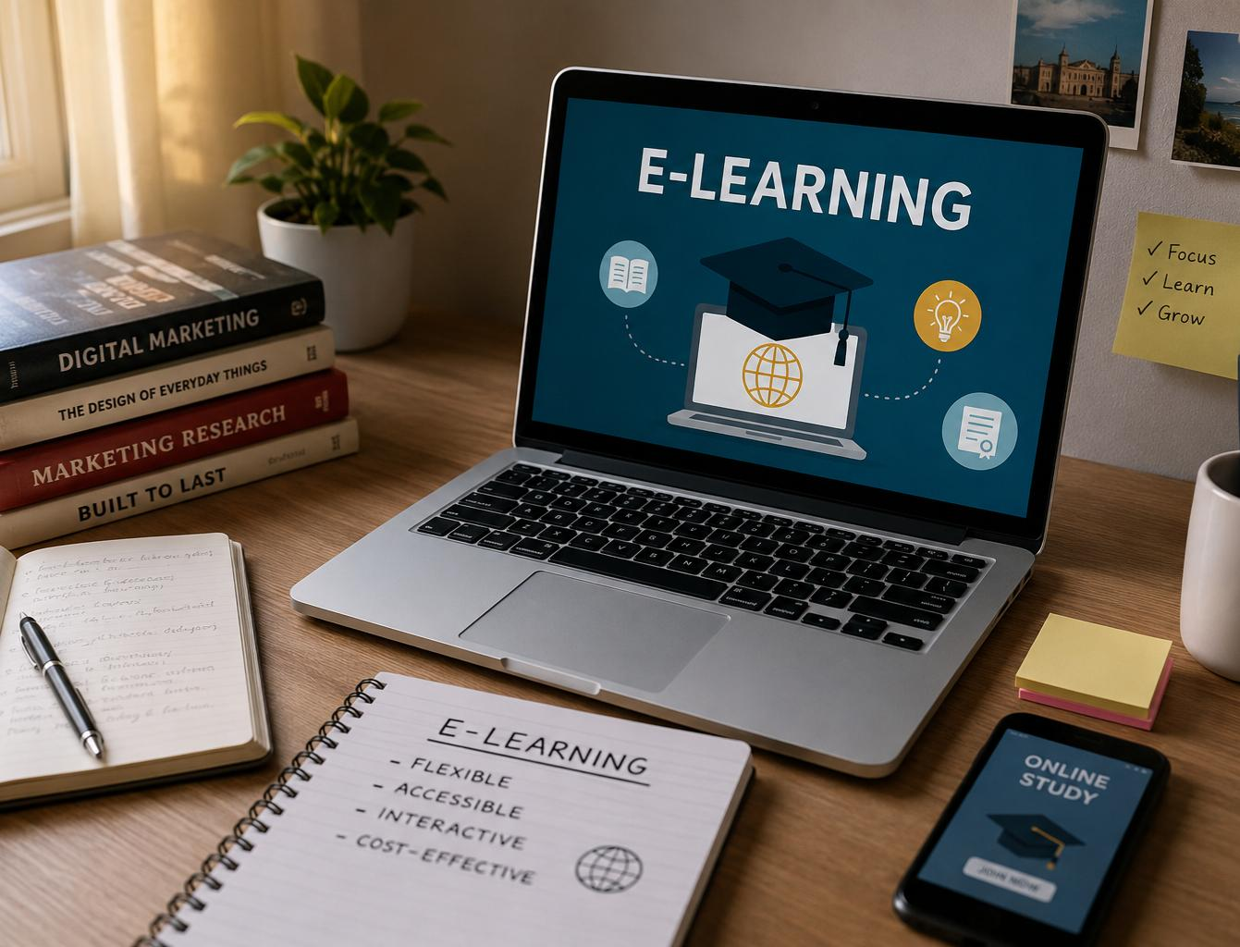
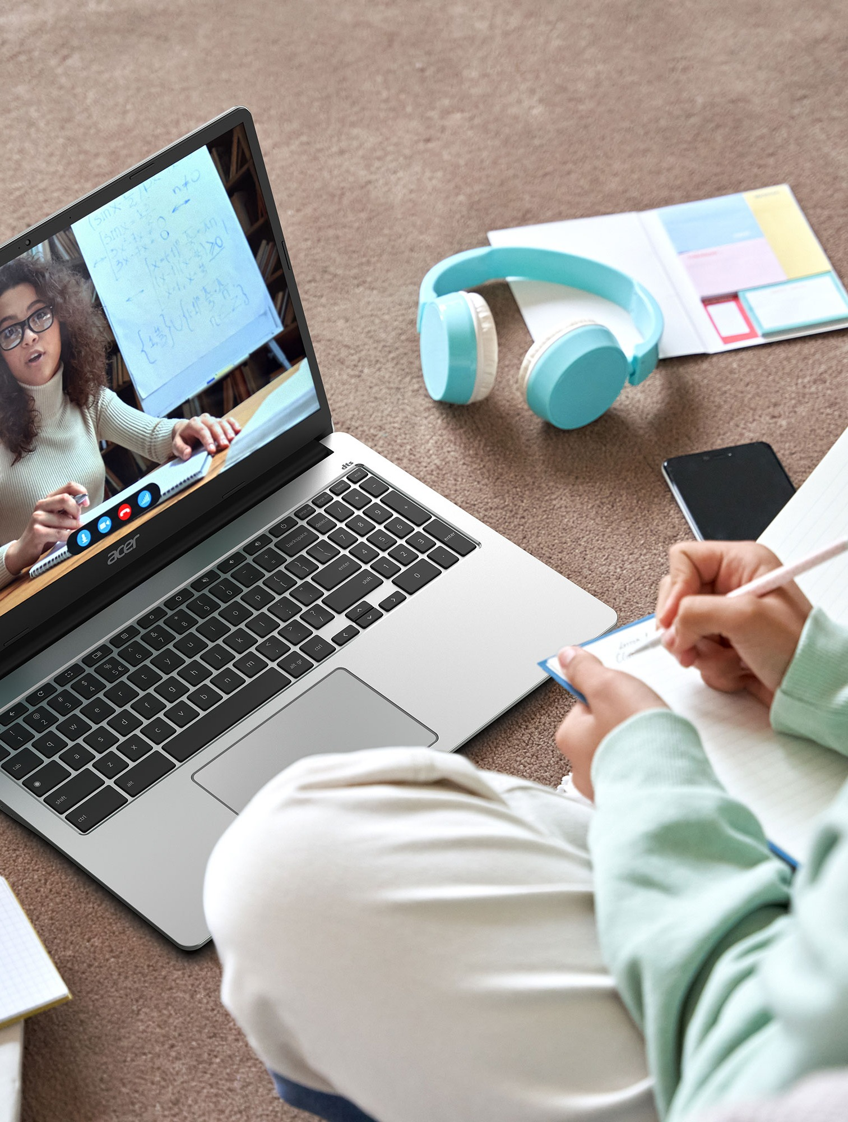
Understanding Internet
as a Source of E-Learning
PREPARED BY:
•PRASANJIT SINGHA
•LOXMON BEY
•BEGUM SUMAIYA AKHTAR
•NEELAKSHI PAUL
•SAMIA MEHJABIN
•MEGHA Das
•Priyanka shIll
DIGITAL LEARNING • CONNECT • EXPLORE
Rabindranath Thakur Vishwavidyalaya • 3rd Semester | 1

Slide 2
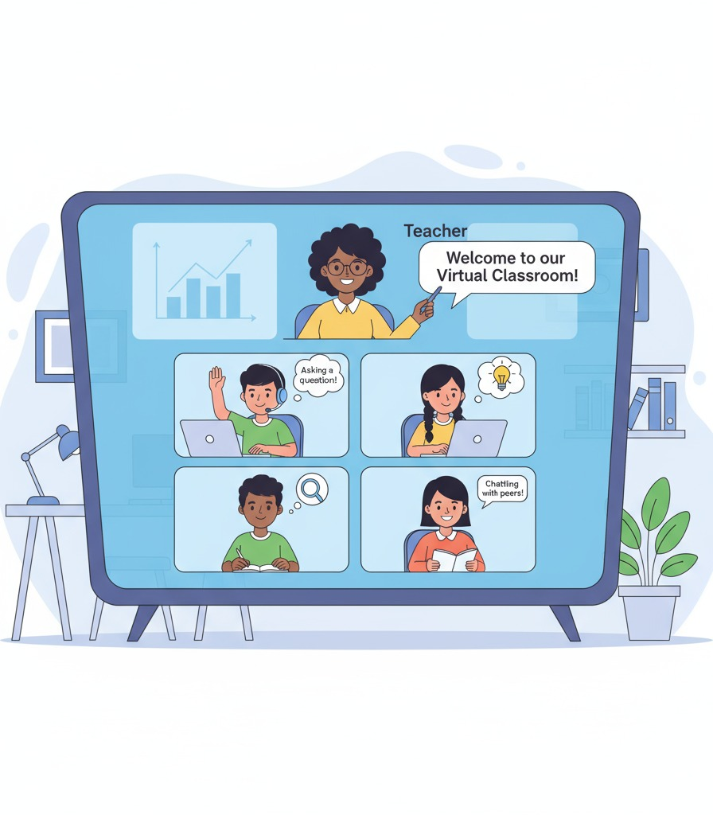
What is E-Learning?
Learning through digital devices, platforms and online resources
• E-learning means learning through electronic devices and digital platforms.
• It gives learners access to lessons, videos, courses and study materials online.
• Learning can happen anytime and from almost anywhere.
• The internet is one of the most important sources of e-learning.
DIGITAL • FLEXIBLE • ACCESSIBLE
Rabindranath Thakur Vishwavidyalaya • 3rd Semester | 2

Slide 3
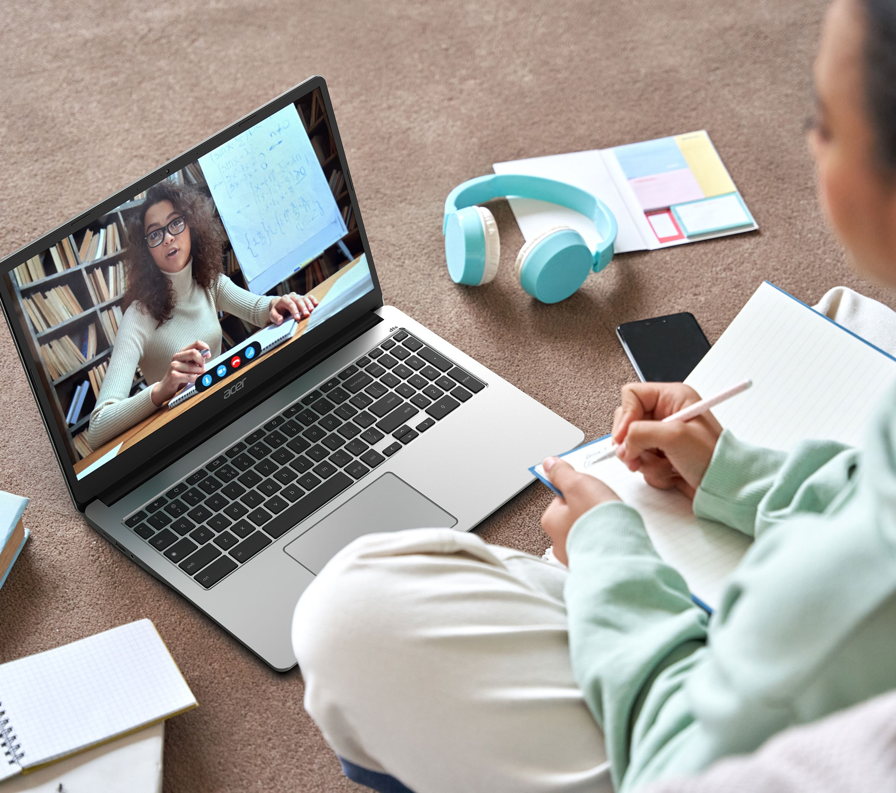
Internet as a Source of E-Learning
One connection can open thousands of learning opportunities.
• Connects learners with educational information.
• Provides digital books, articles, lectures and tutorials.
• Supports both self-learning and teacher-guided learning.
• Helps teachers and students communicate and collaborate.
INFORMATION + COMMUNICATION + LEARNING
Rabindranath Thakur Vishwavidyalaya • 3rd Semester | 3

Slide 4
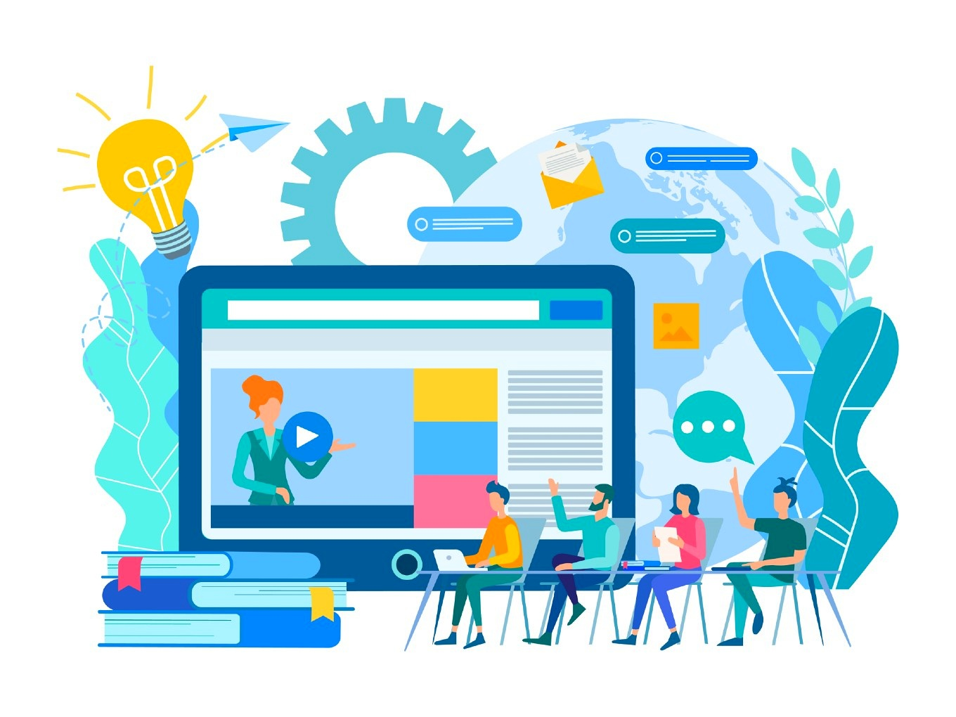

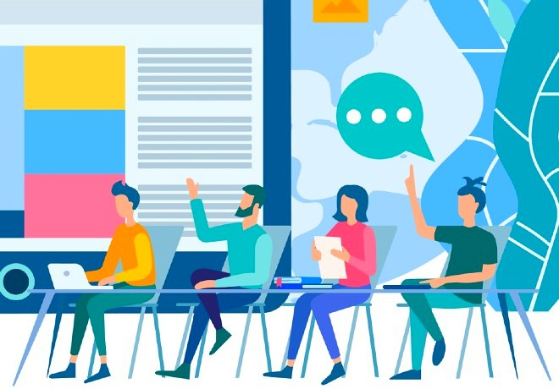
Major Online Learning Resources
Different formats make learning more engaging
01
Educational websites
Articles, notes and reference materials
02
Online courses
Structured lessons and certifications
03
Videos
Lectures, demonstrations and tutorials
04
E-books & journals
Digital reading and research resources
05
Quizzes & forums
Practice, feedback and discussion
Rabindranath Thakur Vishwavidyalaya • 3rd Semester | 4

Slide 5
Role of Internet in Education
How internet-based learning supports students and teachers
1
2
3
Quick access to updated
information
Online classes & virtual
classrooms
Independent and self-paced
learning
4
5
Communication and
collaboration
Learning beyond the classroom
Rabindranath Thakur Vishwavidyalaya • 3rd Semester | 5

Slide 6
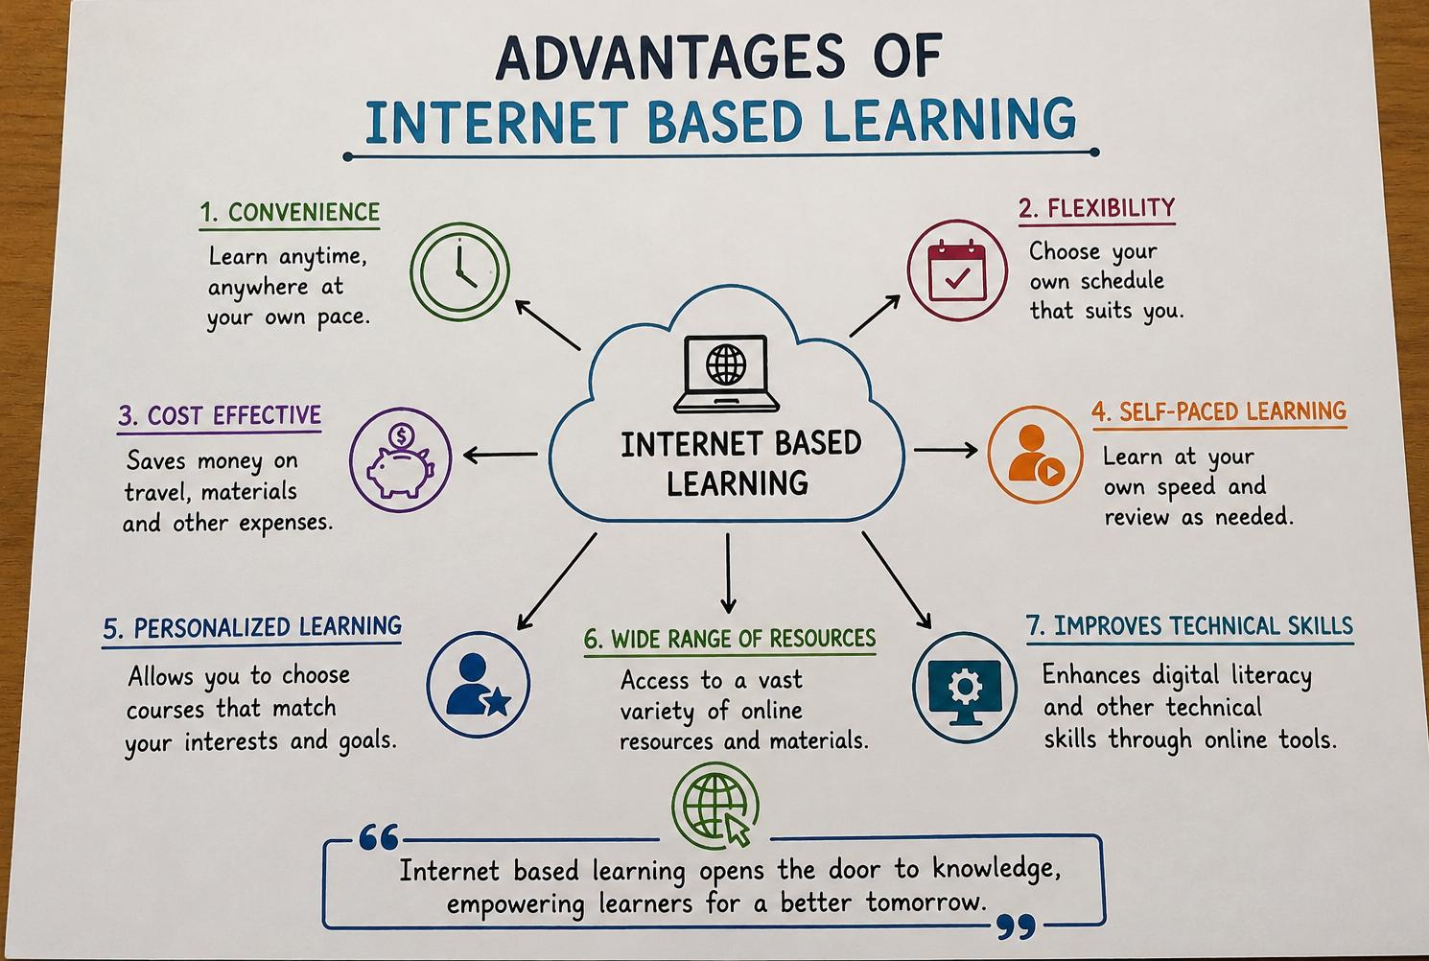
Advantages of Internet-Based Learning
Why students find online learning useful
• Flexible — learn at a convenient time
• Accessible — resources from many locations
• Affordable — many resources are free or low-cost
• Interactive — videos, quizzes and multimedia
• Wide range — subjects beyond the regular syllabus
FLEXIBLE • ACCESSIBLE • INTERACTIVE
Rabindranath Thakur Vishwavidyalaya • 3rd Semester | 6

Slide 7
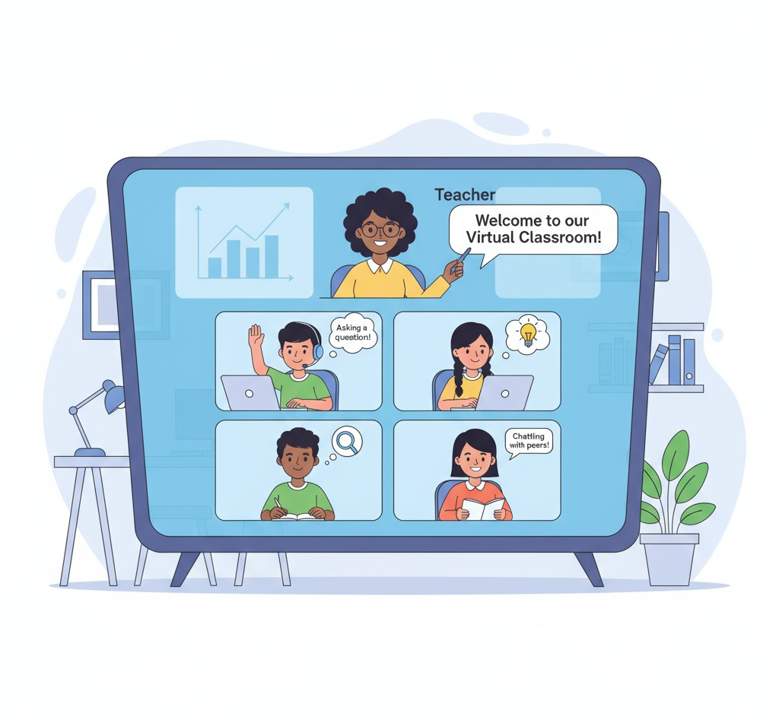
Online Classes & Virtual Learning
Internet tools bring the classroom to the learner
• Live classes can be conducted through video-conferencing tools.
• Recorded lessons allow students to revise difficult topics.
• Teachers can share notes, assignments and announcements.
• Students can participate through chats and online activities.
LIVE + RECORDED + INTERACTIVE
Rabindranath Thakur Vishwavidyalaya • 3rd Semester | 8

Slide 8
Disadvantages & Challenges
Digital learning also requires responsible and balanced use.
01
Unstable internet can interrupt classes.
02
Screen time can cause tiredness or distraction.
03
Not every student has equal device/internet access.
04
Online information may be inaccurate or misleading.
05
Students need self-discipline and time management.
Rabindranath Thakur Vishwavidyalaya • 3rd Semester | 7

Slide 9
Educational Websites & Platforms
Examples of resources students can explore
SWAYAM
Government of India online courses
YouTube
Educational lectures and tutorials
Google Classroom
Assignments and class resources
Khan Academy
Lessons and practice exercises
Digital libraries
E-books, journals and references
SWAYAM
DIKSHA
YOUTUBE
DIGITAL LIBRARIES
Rabindranath Thakur Vishwavidyalaya • 3rd Semester | 9

Slide 10
Role of Students and Teachers
Effective e-learning is a shared responsibility
STUDENTS
TEACHERS
• Search and evaluate information
• Participate actively
• Submit tasks on time
• Use online resources responsibly
• Provide reliable resources
• Guide online learning
• Make lessons interactive
• Support communication
Rabindranath Thakur Vishwavidyalaya • 3rd Semester | 10

Slide 11
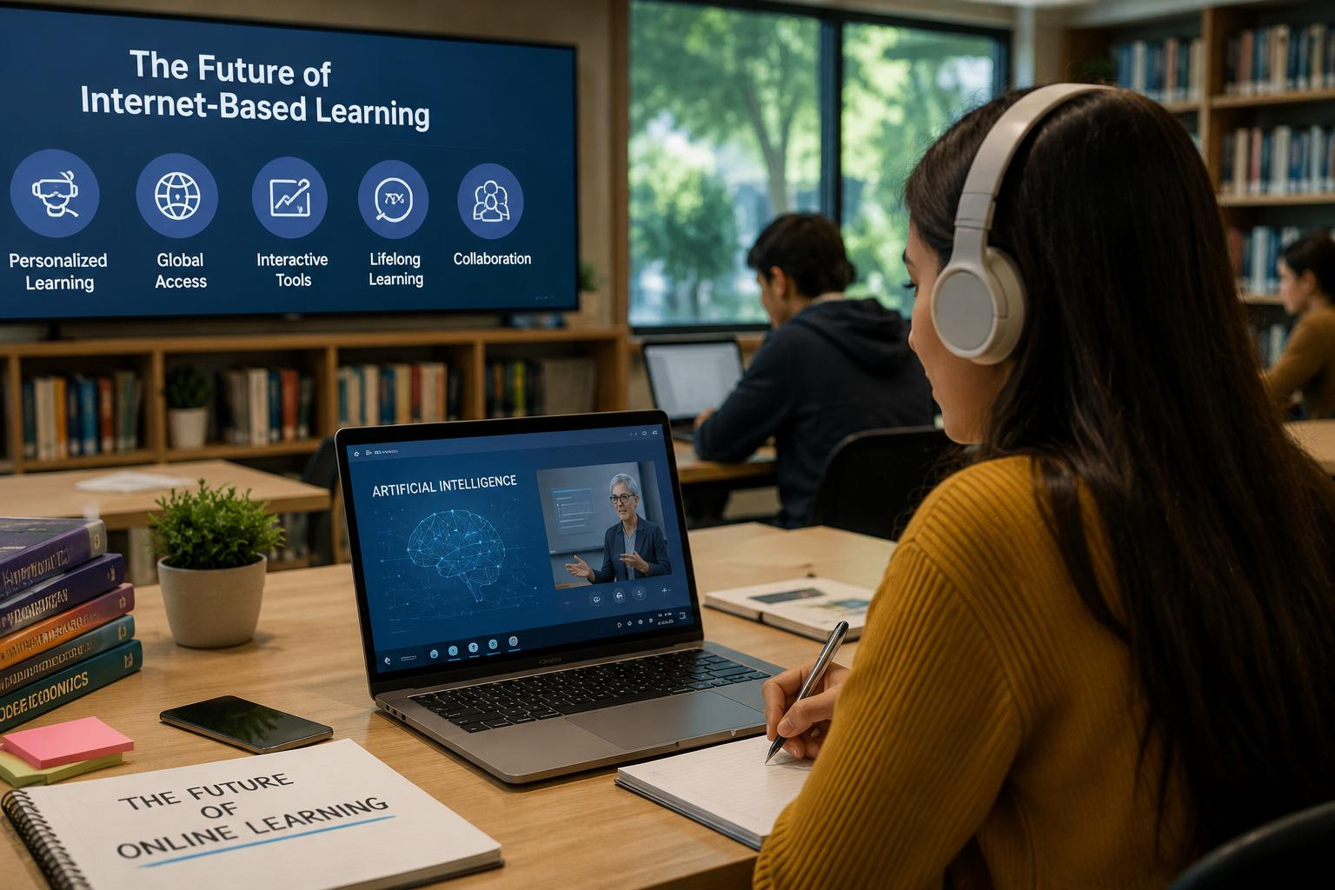
Future of Internet-Based Learning
Technology will continue to reshape education.
• AI-supported personalized learning
• Virtual & augmented reality experiences
• More open online courses and resources
• Blended learning: classroom + digital
• Growing importance of digital skills
THE FUTURE IS DIGITAL
THE FUTURE IS DIGITAL
Rabindranath Thakur Vishwavidyalaya • 3rd Semester | 11

Slide 12
Conclusion
Key message
• The internet has transformed the way people learn and share knowledge.
• It provides flexible, accessible and diverse educational opportunities.
• Learners should use online information carefully and responsibly.
• When used effectively, the internet can make education more inclusive and engaging.
SMART USE OF THE INTERNET = BETTER LEARNING
SMART USE OF THE INTERNET = BETTER LEARNING
Rabindranath Thakur Vishwavidyalaya • 3rd Semester | 12

Slide 13
