Slide 1
LCD PROJECTOR & SMART BOARD
PREPARED BY:-
*SUNITA KUMARI
*ANJALI GUPTA
*NADIA SULTANA
*NEHA BANIK
*KRISHANANANDA SHARMA
*SUBHAMKAR DAS

Slide 2
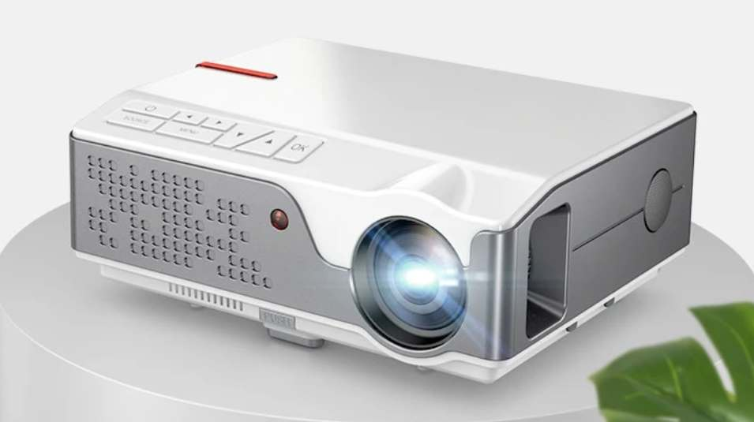
INTRODUCTION
LCD projector is also called multimedia projector. LCD projector is one of the most generalized projector. It can project pictures, graphs, movies, animation and any other type of media. LCD projector works as an output device for the device with which it is attached. The latter works as an input device. Technically we can say that the LCD projector gets its input from some electronic device and projects it on the screen.

Slide 3
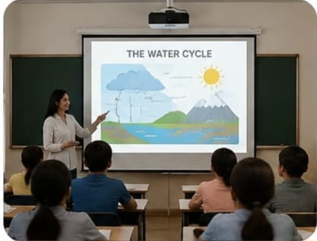
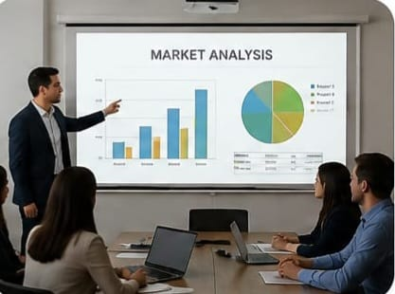
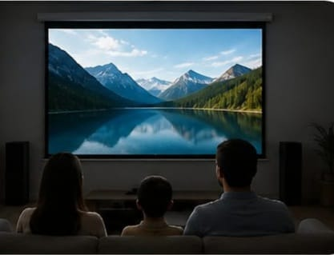
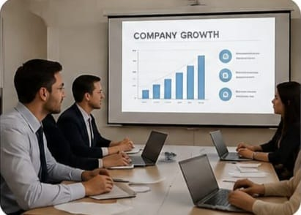
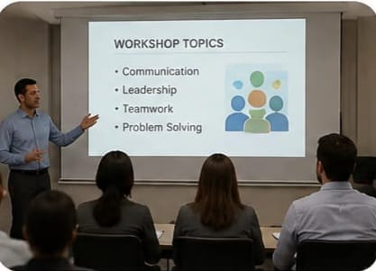
Uses of LCD projector
Classroom teaching presentation watching videos & movies
Business meeting training & workshops

Slide 4
ADVANTAGE OF PROJECTOR
USEFUL FOR LARE CLASS
FOCUSES STUDENT ATTENTION
INCREASES STUDENT TEACHER INTERACTION
Creates a large image that can be viewed by an entire class.
Flexible for classrooms, seminars and large spaces

Slide 5
DIS -ADVANTAGE OF PROJECTOR
Screen door effect:- visible fine grid lines over close-up images.
Lower contrast:- blacks can look grey rather than deep black
Lamp life is limited:- after 3000-6000 hours, the lamp becomes dim and you have to replace it. Replacement lamp is expensive
Bulkier build:- larger and Heavier than DLP equivalents
Wear and tear:- internal panels can degrade or collect dust over time

Slide 6
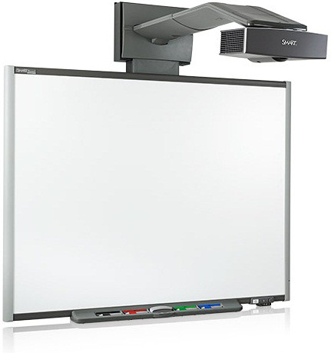
Introduction :-
Smart board is one brand of interactive whiteboard. At its simplest, an interactive whiteboard allows you to project an image and interact with it by writing on it or moving it around. The smart board is connected to a computer and works with a projector. The projector displays what is open on the computer and, rather than using a mouse or keyboard(although you can use those also).

Slide 7
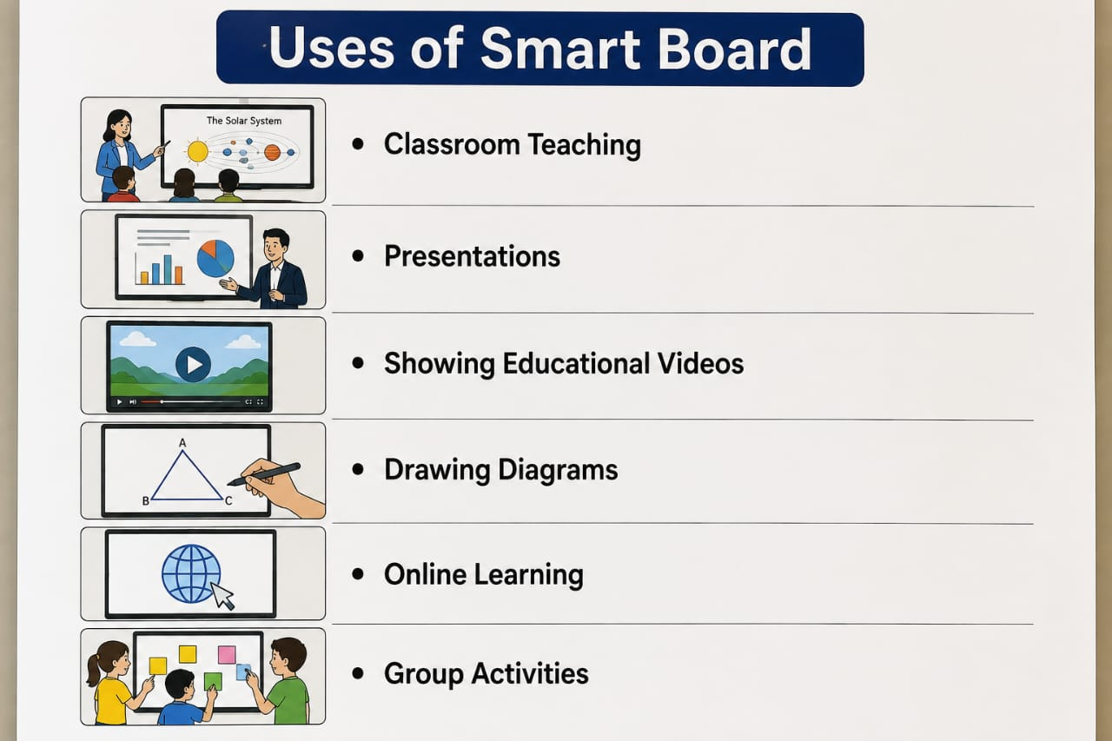

Slide 8
ADVANTAGE & DISADVANTAGE OF SMART BOARD
Interaction learning- students can touch, write and interact with the board
Makes learning interesting – videos, images & animation make lessons more enjoyable
Easy presentation – teachers can present lessons, charts and diagrams clearly
Encourage participation - students can actively take part in classroom activities.
Technical problems – sometimes software or hardware problems may occur
Needs electricity and internet – some functions depend on power and internet connection
Can cause distraction – students may lose focus if technology is not used properly
High cost – smart boards are expensive to buy and maintain

Slide 9


