Slide 1

Concept & Features of ICT
An overview of Information and Communication Technology, its structural components, core features, and real-world impact.
prepared by:
Debasmita Das
Nowrin jahan choudhury
Reha Akther
Sheetal chhetry
Howrambam Ritika Devi
krishanu Bhattacharjee

Slide 2










Imagine a Day Without ICT 🔥
No WhatsApp
No Google
No Online Classes
No UPI
No Video Calls
Instant messaging blacked out
Zero instant answers
Remote learning halts
Digital payments frozen
Global connections cut
“ICT has become a part of our everyday life.”

Slide 3


Understanding the Concept of ICT
What is ICT?
The Power of Convergence
Information and Communication Technology (ICT) is an extended term for Information Technology (IT). It encompasses all communication technologies, including computers, telecommunications, software, middleware, and networking tools that allow users to access, store, transmit, and manipulate information digitally.
The core concept of modern ICT lies in technological convergence—merging traditional audio-visual, telephone, and broadcasting networks with computer networks. This unified infrastructure enables seamless data exchange across the globe in fractions of a second.

Slide 4






Core Components of ICT
Hardware & Infrastructure
Software & Applications
Humanware & Data
Physical equipment including servers, personal computers, mobile devices, fiber-optic cables, routers, and satellite transmission systems.
Operating systems, enterprise software, cloud platforms, databases, and application software that govern data processing and communication.
Engineers, operators, and end-users who interact with systems, generating raw data that is processed into actionable information.

Slide 5

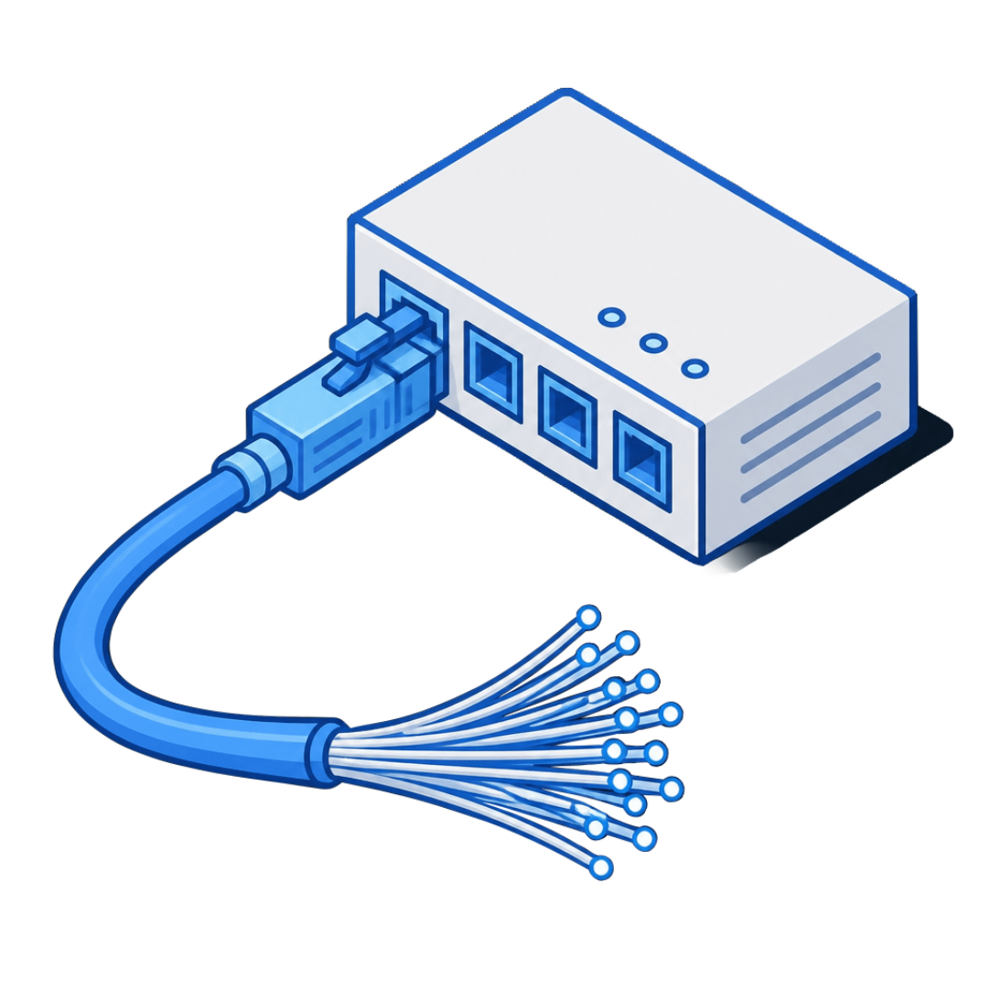

Key Features Make ICT Powerful
Speed
Connectivity
Processes and transmits information in seconds, enabling real-time decisions at any scale.
Links people, devices, institutions, and services across distance and time zones.
Automation
Interactivity & Scalability
Performs repetitive tasks consistently and reliably with limited manual effort.
Supports real-time participation and expands seamlessly as users or data grow.

Slide 6




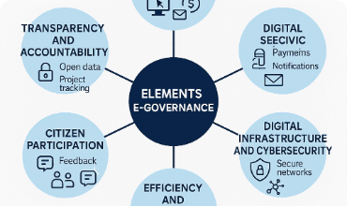

Key Application of ICT
E-Education
E-Governance
E-Commerce
Enables virtual classrooms, e-books, distance learning, and worldwide educational accessibility.
Delivers public services online, enhancing administrative transparency and civic participation.
Powers global digital markets, online transactions, automated logistics, and fintech services.

Slide 7
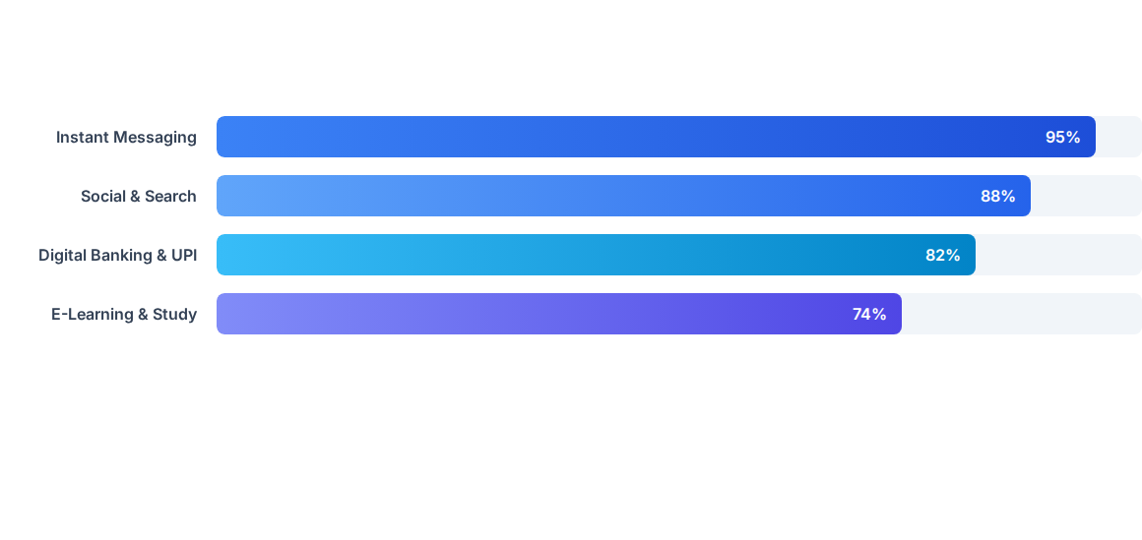
ICT Adoption Impact by Sector
Data shows rapid digitization across key global sectors, driven by the demand for speed, accuracy, and uninterrupted digital service delivery.

Slide 8
Advantages & Challenges
Enhanced Productivity Streamlines operations, reduces manual work, and speeds up decision-making.
Global Connectivity Fosters remote collaboration and opens global markets for businesses of all sizes.
Cybersecurity Concerns Greater dependency increases vulnerability to data breaches, viruses, and cyber attacks.
The Digital Divide Unequal access to infrastructure leaves rural and underdeveloped regions at a disadvantage.

Slide 9




Evolution of Everyday ICT
2020s+
2000s
5G networks, AI assistants, IoT homes, and seamless remote ecosystems.
Mobile cellular phones, search engines, and social media platforms.
1990s
2010s
Basic desktop computing, dial-up internet, and early email systems.
Smartphones, high-speed 4G, cloud storage, and instant UPI payments.

Slide 10
Thank You!
ICT is no longer a luxury — it is the backbone of human connection and innovation.
Questions & Discussion

Slide 11


