Slide 1

GENDER ISSUES IN
SCHOOL EDUCATION
STAGNATION AND DROPOUT
DSC – 302
GENDER AND EDUCATION
RABINDRANATH THAKURVISHWAVIDYALAYA, HOJAI
PRESENTED BY GROUP 7
RUSHMI SHARMA (441) & BIKI SINGHA (440)

Slide 2
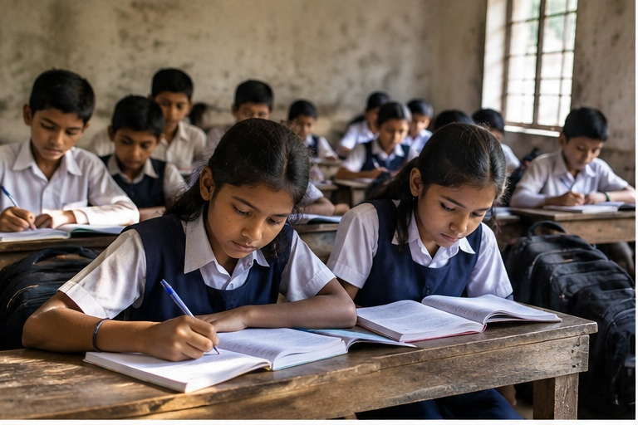
INTRODUCTION
Education should create equal opportunities for every child.
Education is important for the development of every child.
Boys and girls should receive equal opportunities to learn, participate and complete their education.
EXAMPLE
“If a family sends the son to school but keeps the daughter at home for household work, it is gender inequality.”

Slide 3
STAGNATION AND DROPOUT
Two major barriers to educational progress.
STAGNATION
DROPOUT
Stagnation means a student is not progressing properly.
Dropout means leaving school before completing education.
EXAMPLE
EXAMPLE
“A girl who repeats class 7 several times is facing stagnation.”
“A child who leaves school after class 8 and does not return is a dropout.”

Slide 4
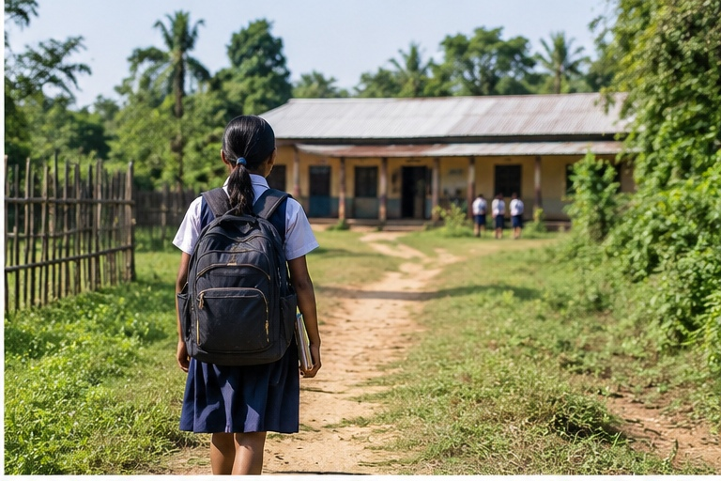
PROBLEMS FACED BY GIRLS
Gender-specific barriers can interrupt regular schooling.
Key challenges
• Household work and family responsibilities.
• Early marriage and safety concerns.
• Lack of private toilets and menstrual facilities.
EXAMPLE: A girl may miss school because there is no private toilet or water facility. Gradually, she may fall behind and leave school.

Slide 5
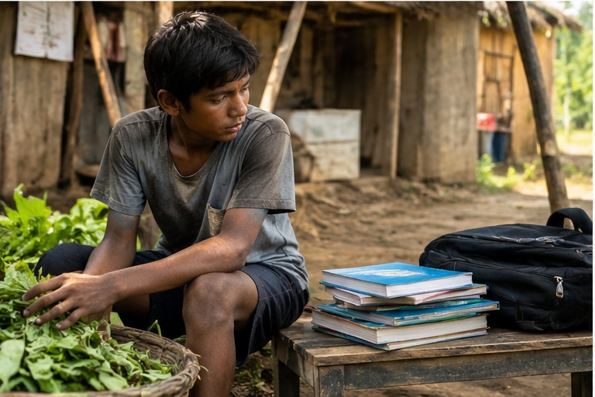
PROBLEMS FACED BY BOYS
Economic responsibilities can also lead to school dropout.
Common pressures
• Leaving school to earn money.
• Child labour and family work.
• Migration and unstable family conditions.
EXAMPLE: “A boy may leave school after class 8 to work in a shop because his family needs money.”

Slide 6
MAIN CAUSES
Why do students stagnate or leave school?
Poverty
Long distance to school
Unsafe transport
Poor school facilities
Bullying and discrimination
Failure in examinations
EXAMPLE: “If a student travels 10 kilometres to school and there is no safe transport, the student may attend irregularly and eventually dropout.”

Slide 7
EFFECTS
The consequences continue far beyond the classroom.
1
2
3
Future opportunities
Economic impact
Personal impact
Dropout reduces future job opportunities.
It can increase poverty, unemployment and child labour.
It lowers confidence and social participation.
EXAMPLE: A student who leaves school early may get only low-paid work and may find it difficult to improve their economic condition.

Slide 8
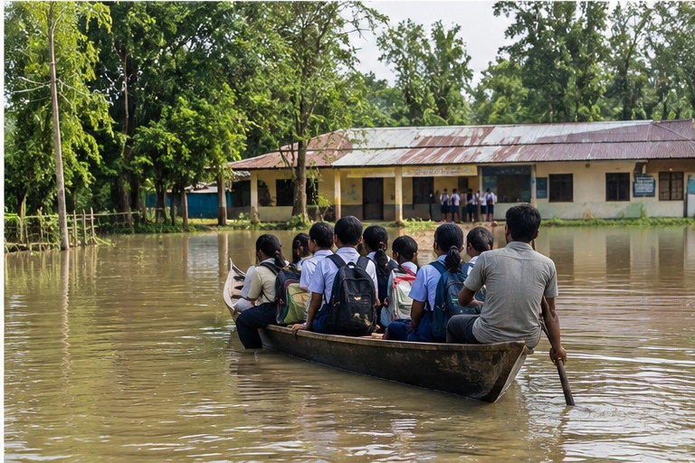
ASSAM CONTEXT
Local geography and economic conditions can interrupt education.
25.1%
Secondary Dropout Rate
(2023–24)
Challenges in Assam
• Rural, remote, flood-prone and river-island areas.
• Floods, erosion, distance and poverty interrupt education.
EXAMPLE: During floods, a family may move to another place. The child may lose contact with the school and fail to continue education.

Slide 9
SOLUTIONS
Practical support can keep children connected to education.
What can be done?
• Provide scholarships and free educational materials.
• Improve toilets, water and transport.
• Provide counselling and remedial classes.
• Prevent child marriage and child labour.
EXAMPLE: “If a girl receives a bicycle or safe transport, she can travel to a distant secondary school and continue her education.”

Slide 10
CONCLUSION
Equal support can help every learner complete their educational journey.
Key message
• Boys and girls face different educational problems.
• Equal support can reduce stagnation and dropout.
• Every child has the right to quality education.
“School, families, communities and the government must work together so that no child leaves school early.”

Slide 11

THANK YOU
Every child deserves the chance to learn, grow and succeed.
QUESTIONS & DISCUSSION

