Slide 1
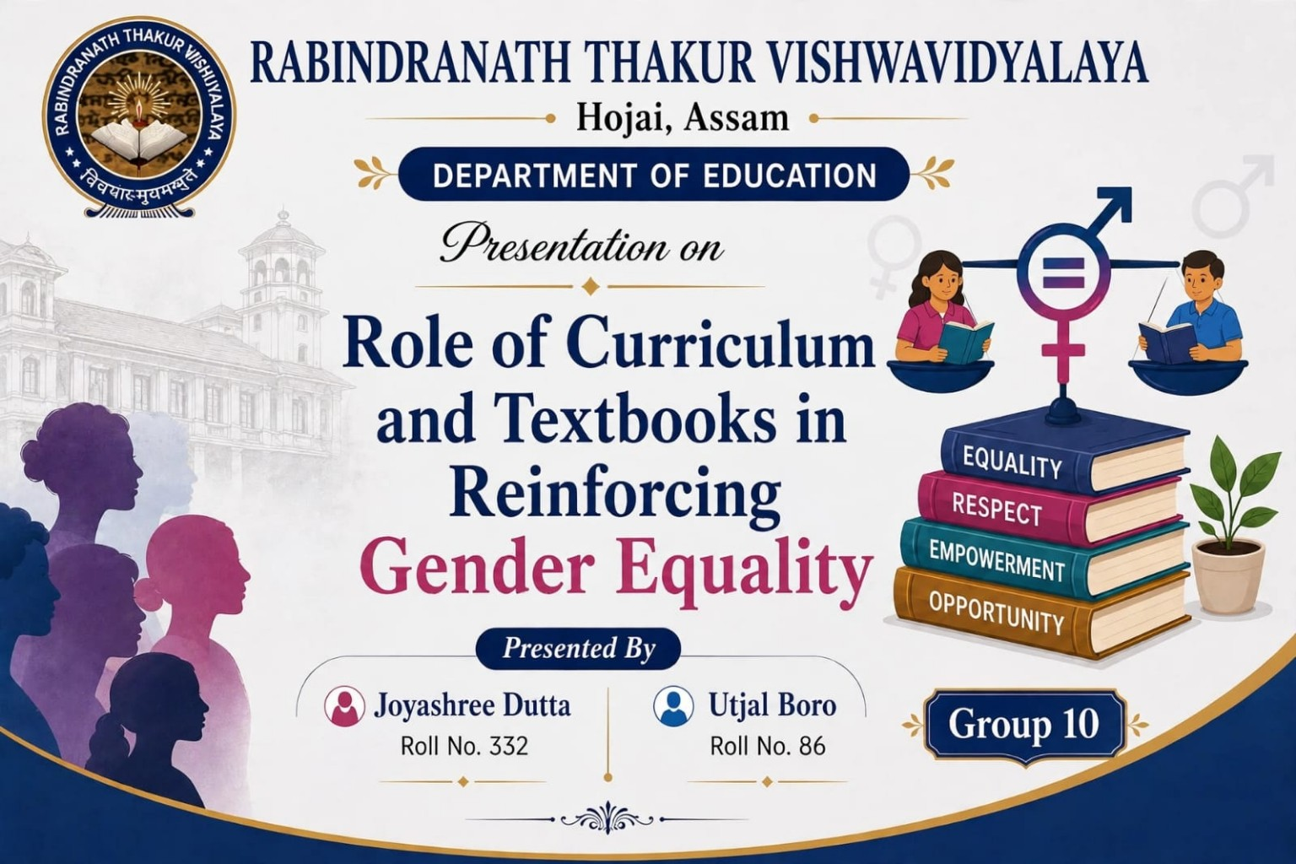

Slide 2

What is Gender Equality?
✓
Gender equality means giving every individual, regardless of their gender, the same rights, opportunities and respect.
✓
It is about fairness, not sameness.

Slide 3
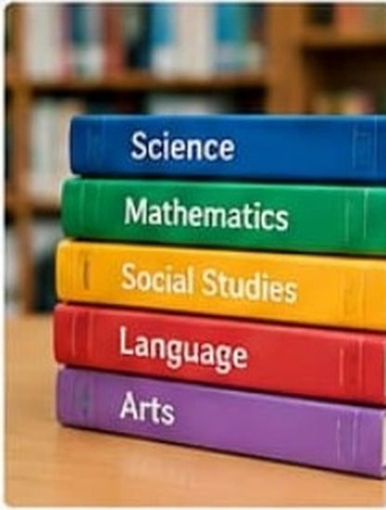
Why Curriculum and Textbooks Matter?
✓
They shape what children learn, think and believe.
✓
They influence attitudes, values and behaviour.
✓
They can either challenge stereotypes or reinforce them.

Slide 4

How Curriculum Promotes Gender Equality
✓
Includes equal participation of girls and boys in all subjects and activities.
✓
Recognises diverse roles and contributions of both genders.
✓
Encourages critical thinking about gender stereotypes.
✓
Promotes respect, empathy and shared responsibilities.

Slide 5
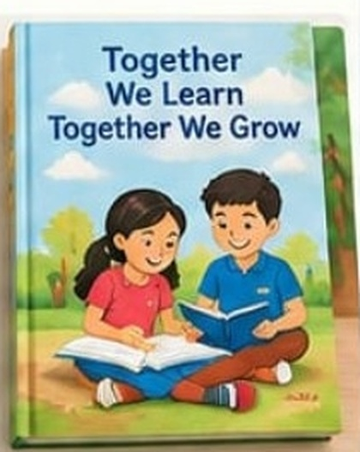
How Textbooks Reinforce Equality
✓
Show equal representation of women and men in stories, images and examples.
✓
Present women in leadership, science, sports, politics and other diverse fields.
✓
Avoid gender-biased language (e.g., “he” only).
✓
Include varied family structures and shared household roles.

Slide 6




Examples of Gender-Responsive Content
Women in Science
Men in Teaching
Girls in Sports
Boys in Household Work

Slide 7

Addressing Stereotypes
✓
Challenge traditional gender roles and limiting beliefs.
✓
Show girls and boys in non-traditional roles.
✓
Build confidence and self-esteem in all learners.

Slide 8

Benefits of Gender-Equal Curriculum and Textbooks
✓
Reduces discrimination and violence.
✓
Creates a more inclusive and positive learning environment.
✓
Leads to a fairer and more just society.

Slide 9

Challenges
Deep rooted cultural and social mindsets.
Limited availability of gender-sensitive teaching materials.
Resistance to change.

Slide 10

Conclusion
Curriculum and textbooks are powerful tools. When they are designed in a gender-sensitive way, they can break stereotypes, promote equal opportunities and help build a society where every individual — regardless of gender — can reach their full potential.

Slide 11
Thank You!
Let’s build a more inclusive
and equal world through education.
— ♥ —

