Slide 1


Slide 2
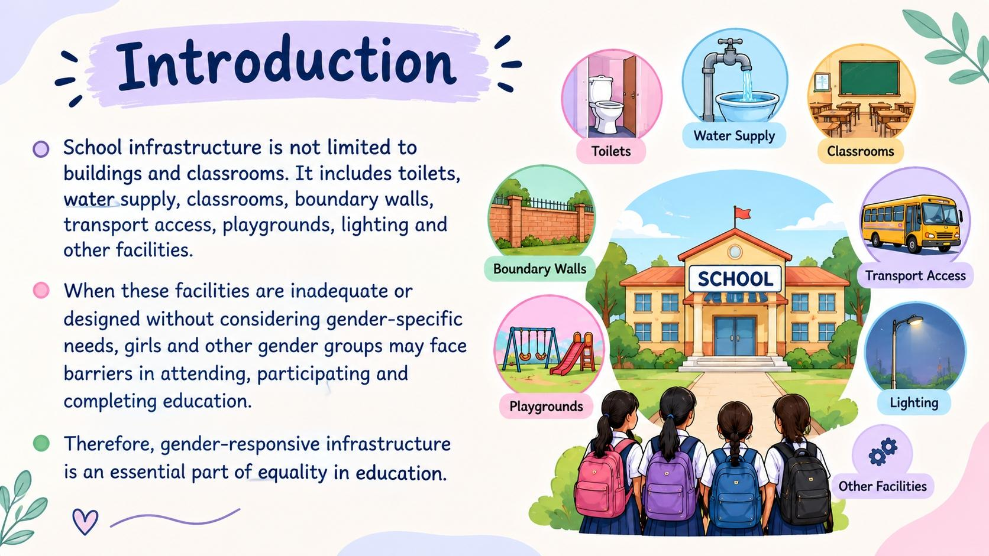
Introduction
School infrastructure is not limited to buildings and classrooms. It includes toilets, water supply, classrooms, boundary walls, transport access, playgrounds, lighting and other facilities.
When these facilities are inadequate or designed without considering gender-specific needs, girls and other gender groups may face barriers in attending, participating and completing education.
Therefore, gender-responsive infrastructure is an essential part of equality in education.

Slide 3
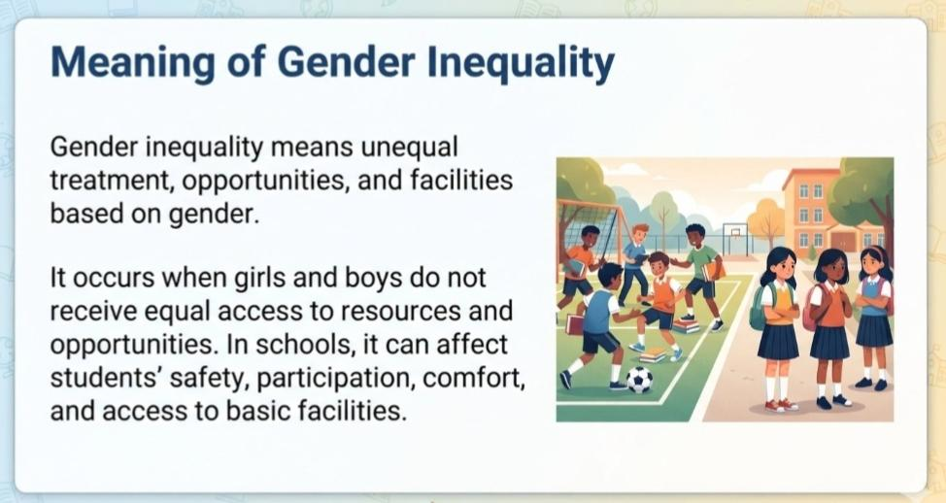
Meaning of Gender Inequality
Gender inequality means unequal treatment, opportunities, and facilities based on gender.
It occurs when girls and boys do not receive equal access to resources and opportunities.
In schools, it can affect students’ safety, participation, comfort, and access to basic facilities.

Slide 4
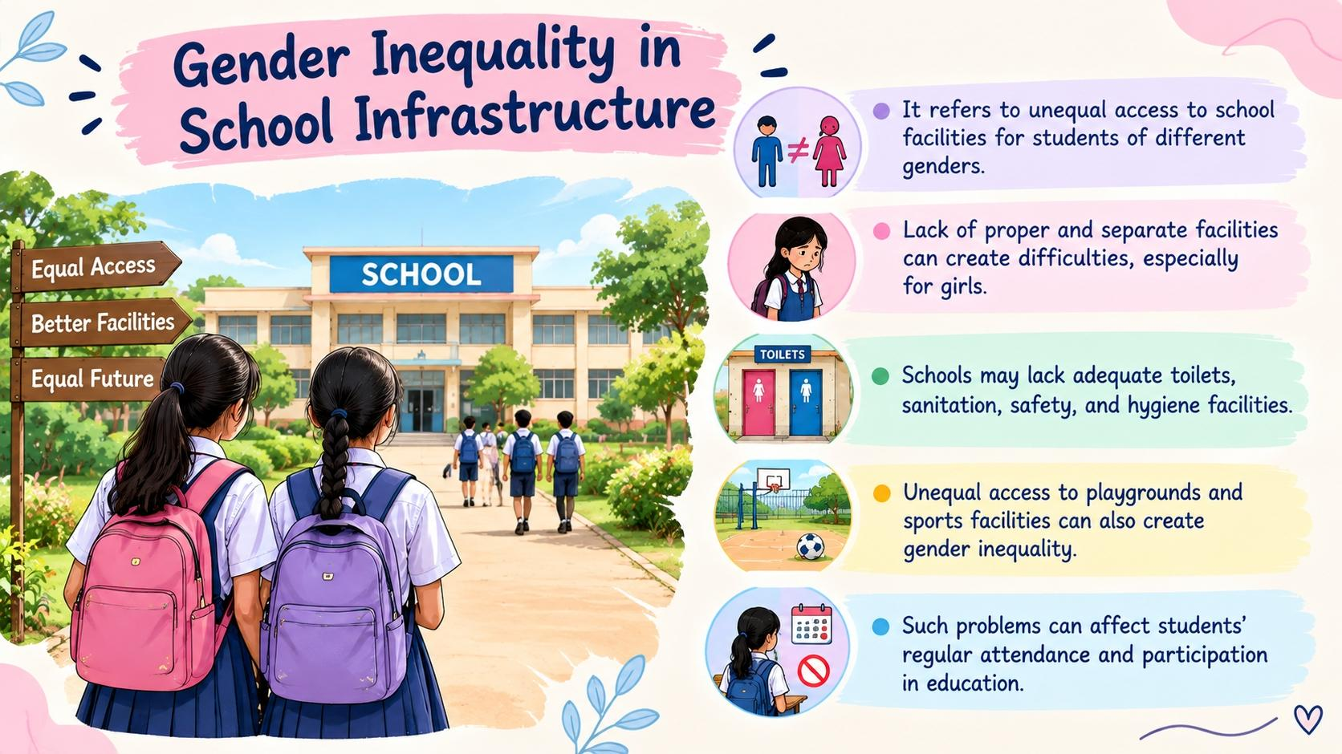
Gender Inequality in School Infrastructure
It refers to unequal access to school facilities for students of different genders.
Lack of proper and separate facilities can create difficulties, especially for girls.
Schools may lack adequate toilets, sanitation, safety, and hygiene facilities.
Unequal access to playgrounds and sports facilities can also create gender inequality.
Such problems can affect students’ regular attendance and participation in education.

Slide 5
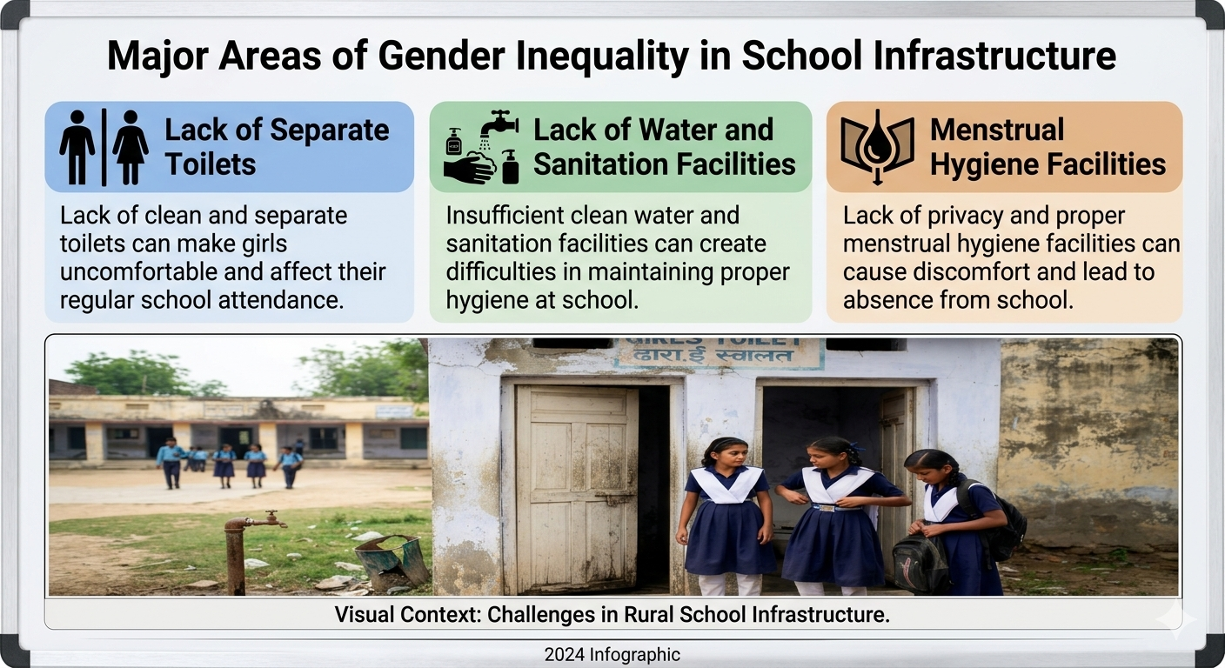
Major Areas of Gender Inequality in School Infrastructure
Lack of Separate Toilets
Lack of clean and separate toilets can make girls uncomfortable and affect their regular school attendance.
Lack of Water and Sanitation Facilities
Insufficient clean water and sanitation facilities can create difficulties in maintaining proper hygiene at school.
Menstrual Hygiene Facilities
Lack of privacy and proper menstrual hygiene facilities can cause discomfort and lead to absence from school.

Slide 6
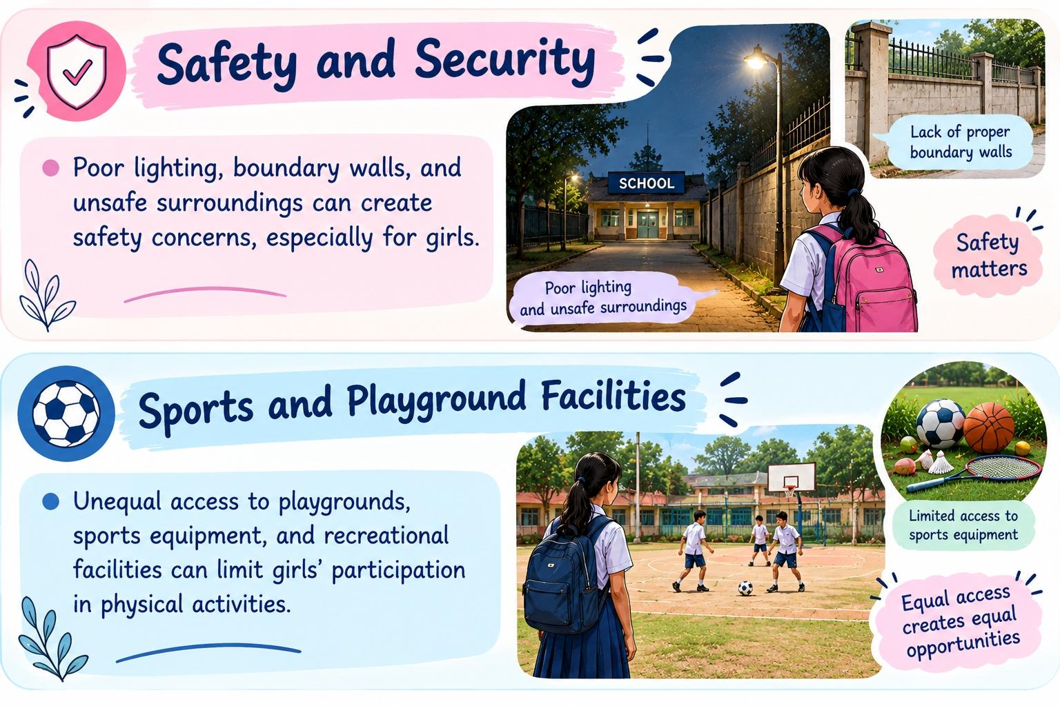
Safety and Security
Poor lighting, boundary walls, and unsafe surroundings can create safety concerns, especially for girls.
Sports and Playground Facilities
Unequal access to playgrounds, sports equipment, and recreational facilities can limit girls’ participation in physical activities.

Slide 7
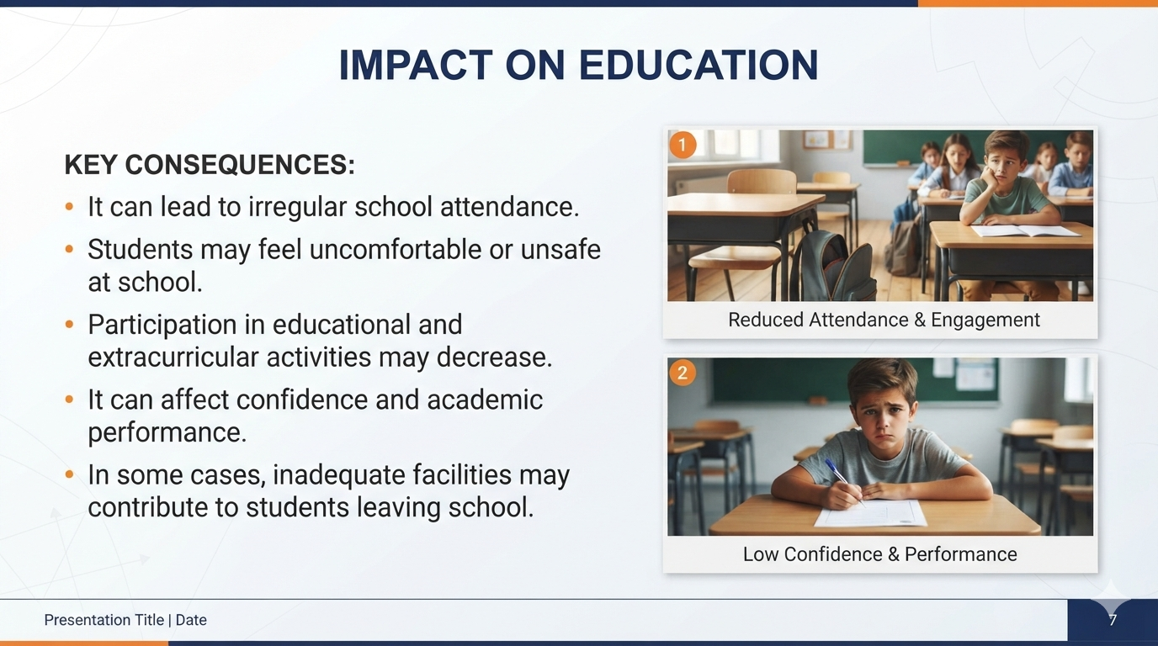
Impact on Education
It can lead to irregular school attendance.
Students may feel uncomfortable or unsafe at school.
Participation in educational and extracurricular activities may decrease.
It can affect confidence and academic performance.
In some cases, inadequate facilities may contribute to students leaving school.

Slide 8
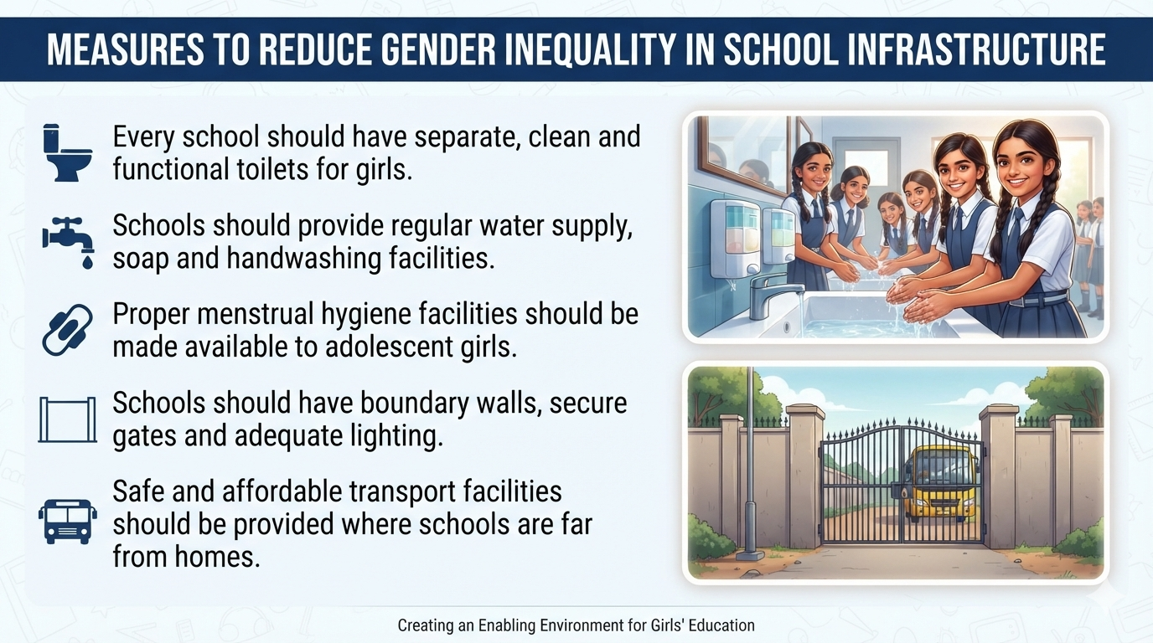
Measures to Reduce Gender Inequality in School Infrastructure
Every school should have separate, clean and functional toilets for girls.
Schools should provide regular water supply, soap and handwashing facilities.
Proper menstrual hygiene facilities should be made available to adolescent girls.
Schools should have boundary walls, secure gates and adequate lighting.
Safe and affordable transport facilities should be provided where schools are far from homes.

Slide 9
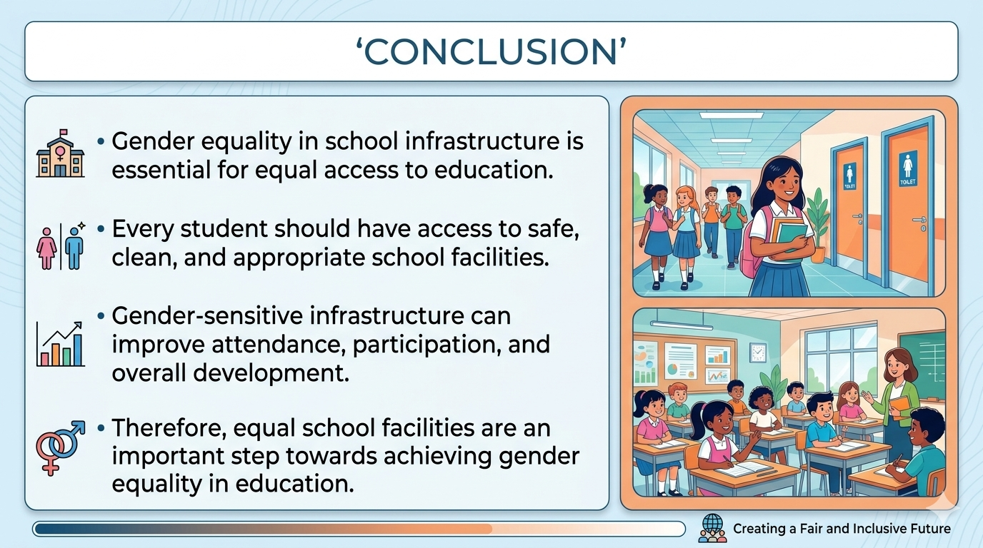
Conclusion
Gender equality in school infrastructure is essential for equal access to education.
Every student should have access to safe, clean, and appropriate school facilities.
Gender-sensitive infrastructure can improve attendance, participation, and overall development.
Therefore, equal school facilities are an important step towards achieving gender equality in education.

Slide 10

Thank you 🌝

