Slide 1
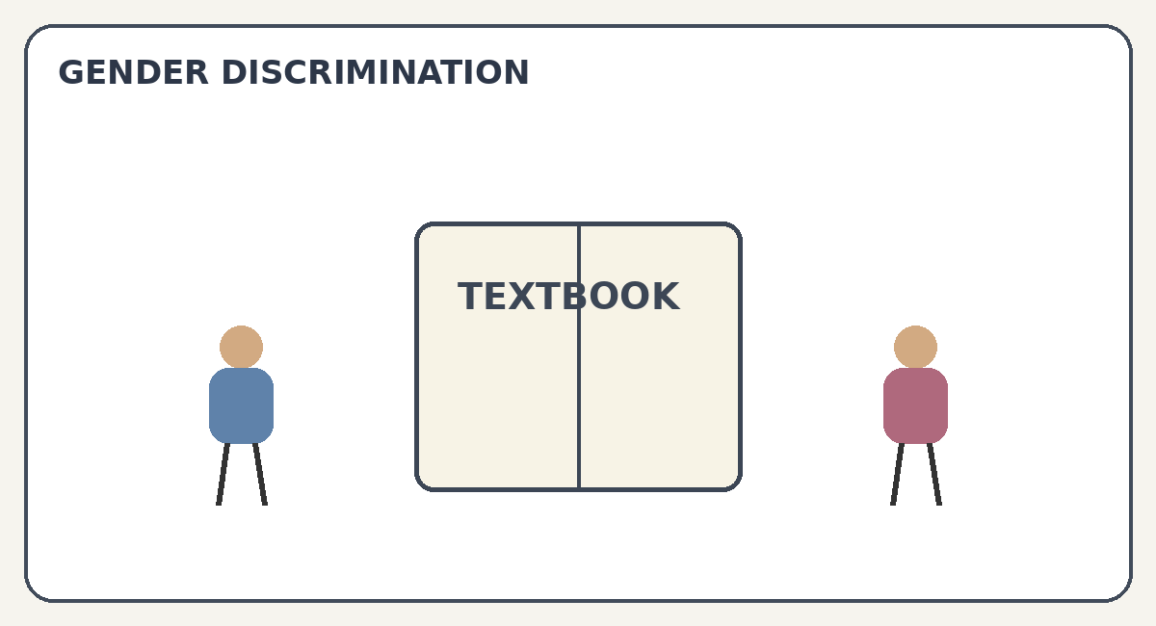
GENDER DISCRIMINATION
IN TEXTBOOK
Classroom Presentation
Sonali Nath
Tamanna Begum
Junaki Das
1

Slide 2
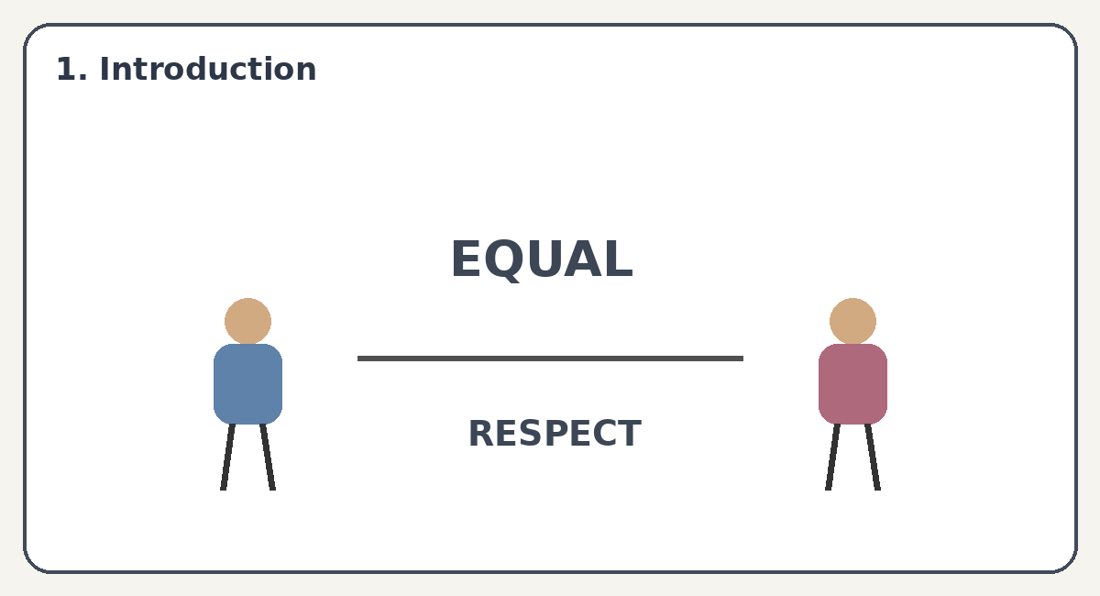
1. Introduction
• Textbooks help us learn about the world.
• They can also shape our ideas about girls and boys.
• Sometimes they show unequal or limited roles.
• Fair textbooks give everyone equal importance.
2

Slide 3
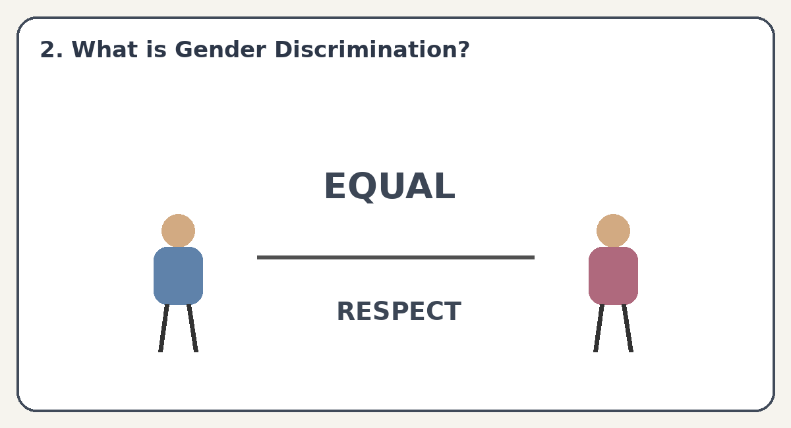
2. What is Gender Discrimination?
• It means treating someone unfairly because of gender.
• It can appear in words, pictures, stories and examples.
• It may give one gender more importance than another.
• Equal representation helps create a fair learning environment.
3

Slide 4
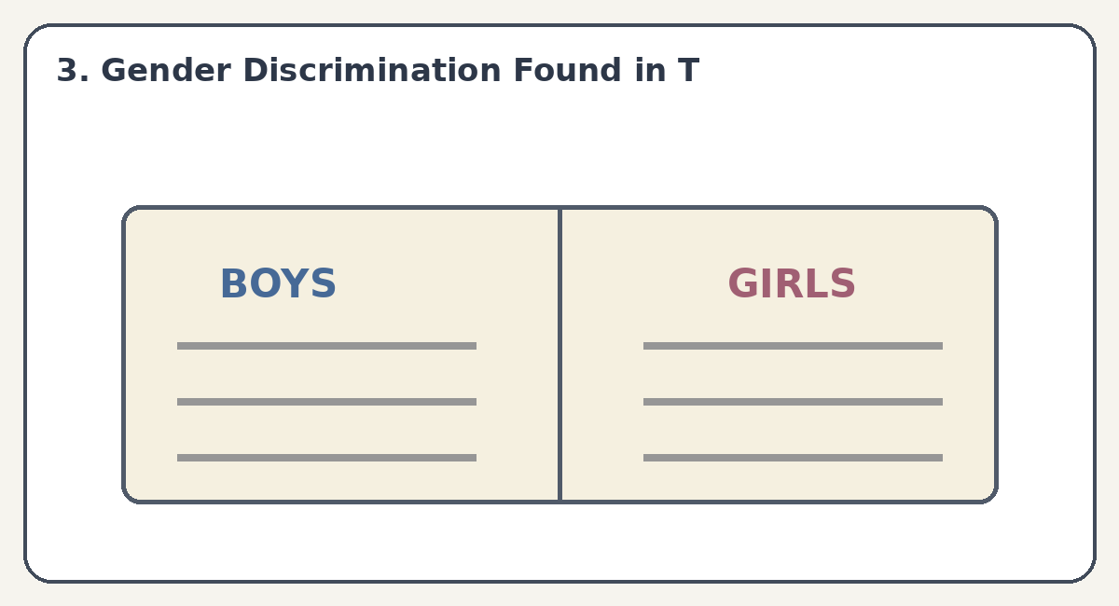
3. Gender Discrimination Found in Textbooks
• Under-representation of women: women may appear less as leaders or experts.
• Language bias: boys may be described as strong and girls as gentle.
• Domestic work: women are often shown doing most housework.
• Career roles: men may be shown in leadership jobs and women mainly as caregivers.
4

Slide 5
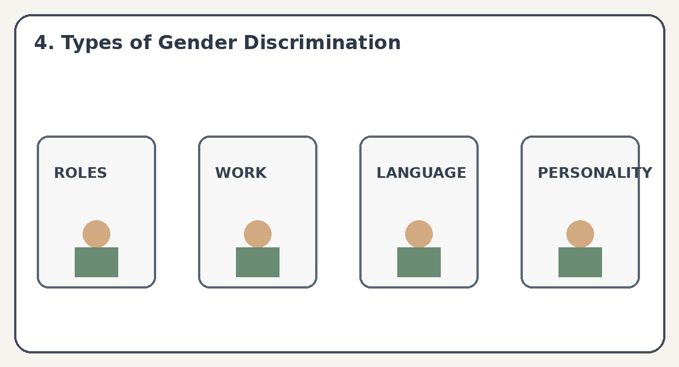
4. Types of Gender Discrimination
• Role Assignment – different duties are given to boys and girls.
• Occupational Bias – some careers are shown as suitable for only one gender.
• Language Bias – words can create unfair ideas about gender.
• Personality Stereotyping – boys may be shown as brave and girls as quiet or caring.
5

Slide 6
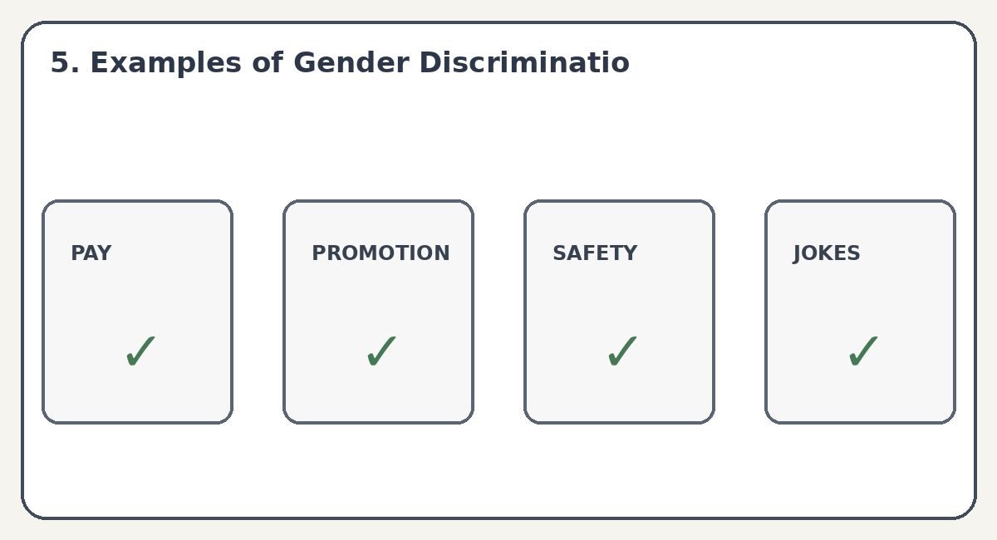
5. Examples of Gender Discrimination
• Lower salary – people doing similar work should receive fair pay.
• Promotion problems – qualified women may get fewer leadership chances.
• Sexual harassment – unwanted behaviour can make a place unsafe.
• Inappropriate jokes – gender-based jokes can hurt and disrespect people.
6

Slide 7
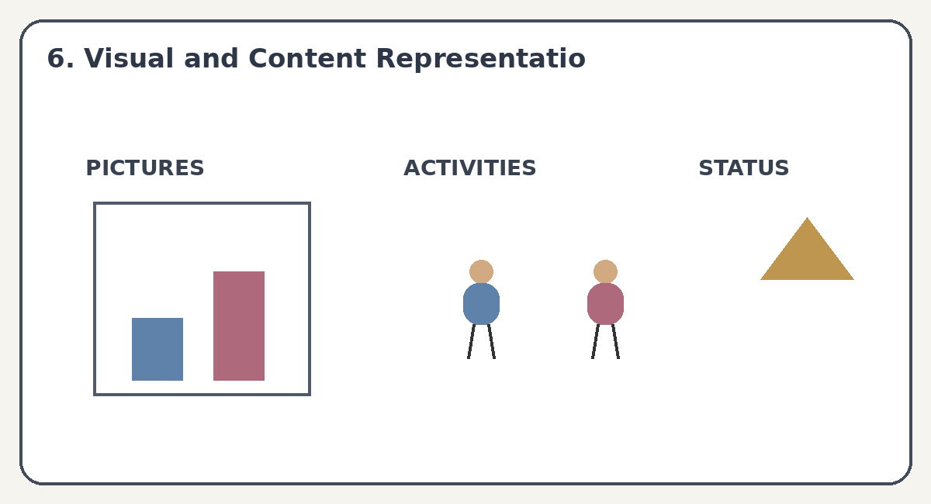
6. Visual and Content Representation
• Visual ratio – check whether girls and boys appear in a balanced way.
• Activity levels – notice who is shown doing active or creative activities.
• Status representation – see who is shown as a leader or decision-maker.
• Both genders should be shown in many different roles.
7

Slide 8
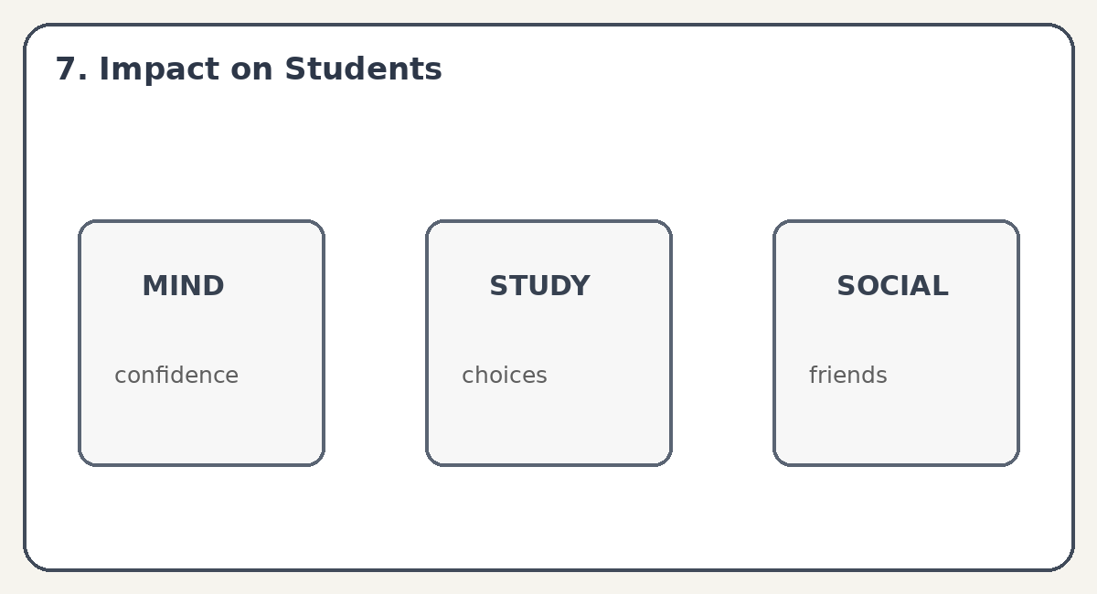
7. Impact on Students
• Psychological: stereotypes may lower confidence and self-esteem.
• Academic & career: students may avoid subjects or careers they think are for another gender.
• Social: strict gender roles can affect friendships and behaviour.
• Students should be free to follow their interests and abilities.
8

Slide 9
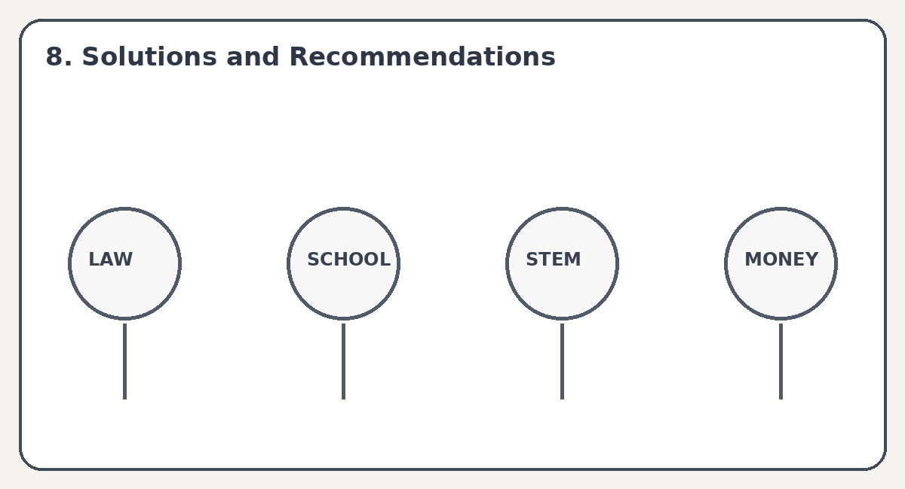
8. Solutions and Recommendations
• Policy: support equal pay and fair representation.
• Curriculum reform: use balanced language, pictures and examples.
• Education: encourage students to explore STEM, care and other fields freely.
• Economic empowerment: teach financial literacy and support equal property rights.
9

Slide 10
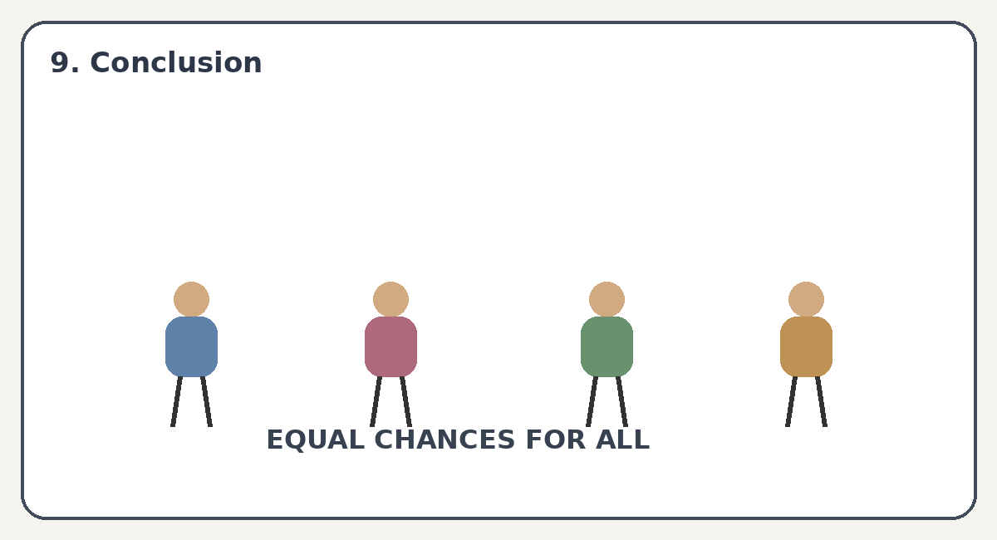
9. Conclusion
• Textbooks should give equal respect and importance to all genders.
• Fair language, pictures and examples can reduce stereotypes.
• Education should help students choose their future by interest and ability.
• Gender equality starts with equal opportunities.
10

Slide 11
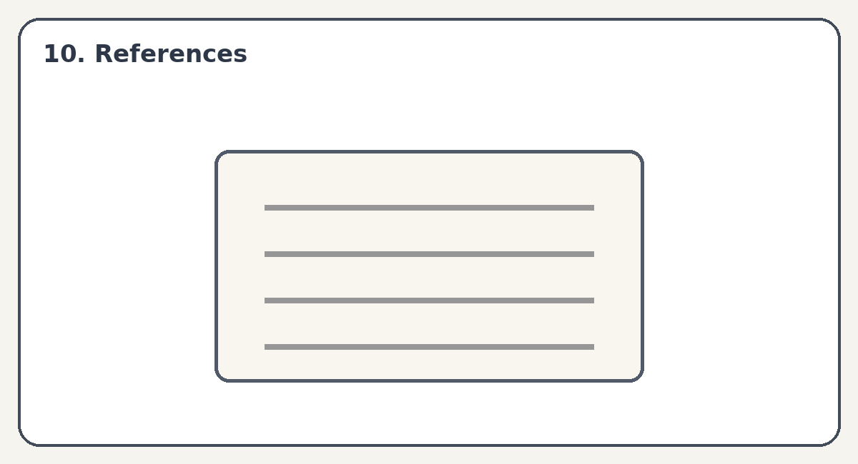
10. References
• NCERT educational resources
• UNESCO resources on gender equality in education
• UN Women materials on gender equality
• Class notes and textbook examples
11

Slide 12
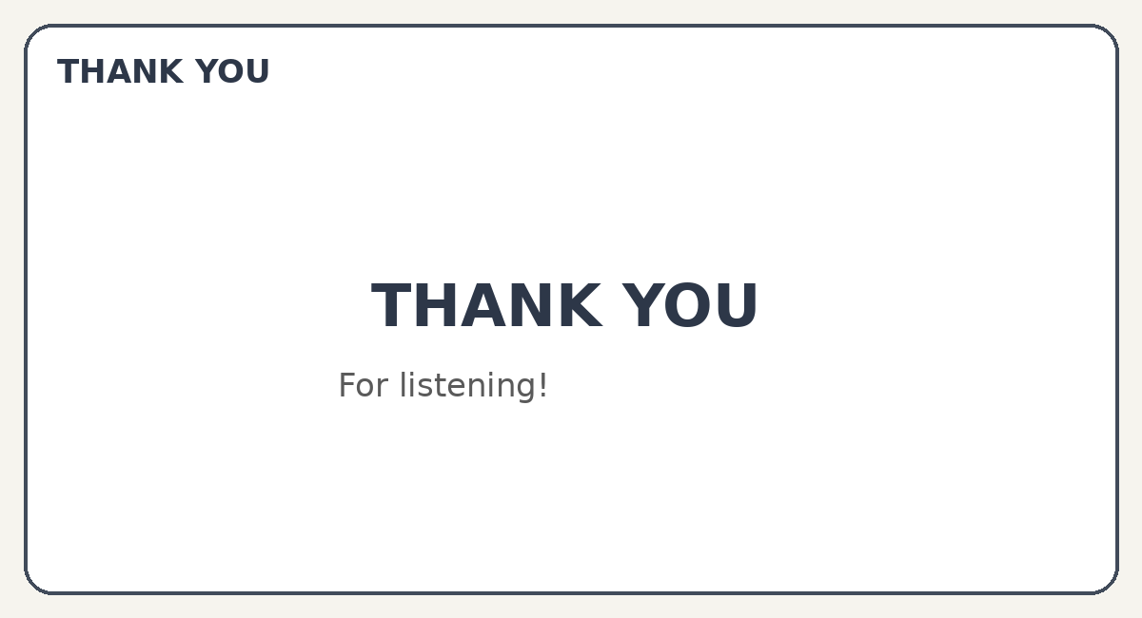
THANK YOU
Thank you for listening!
Sonali Nath • Tamanna Begum • Junaki Das
12

