Slide 1
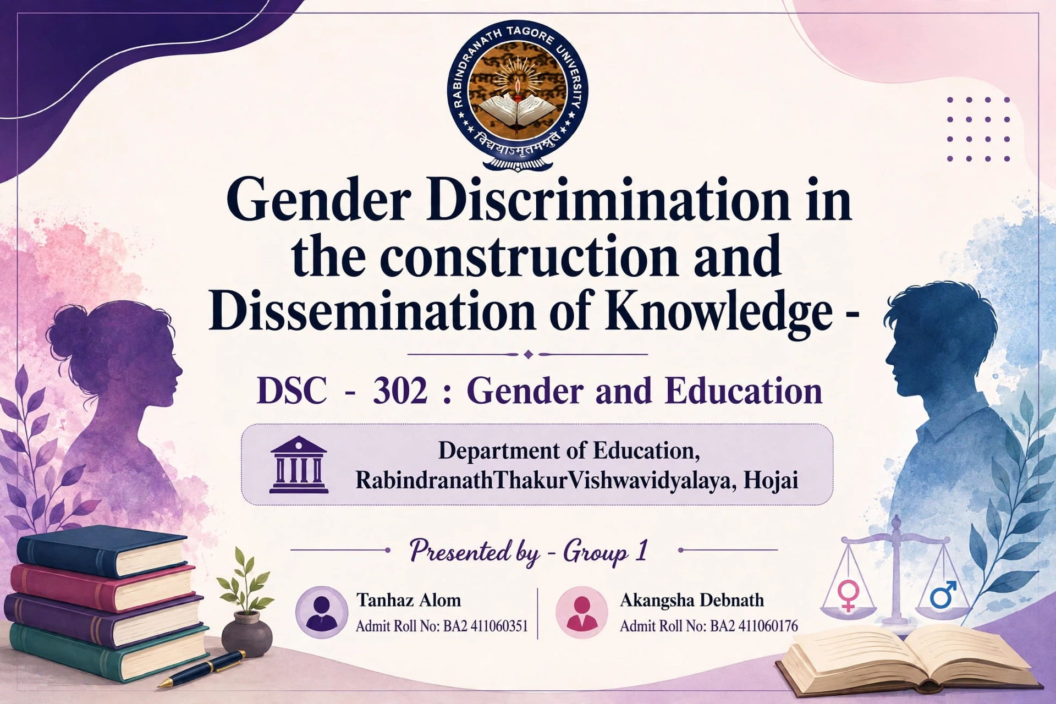

Slide 2
Introduction:
Gender Discrimination refers to treating a person unfairly only because she is a girl or he is a boy. For example, saying boys can study more and girls should do only housework. It is made by society, not by nature
Construction of Knowledge is defined as the process whare knowledge is not given us. We build it ourselves from our own experiences, family, society, school and culture. If society thinks boys are stronger, then our knowledge also becomes biased
Dissemination of Knowledge implies how we share our knowledge with others. We share it through books, TV, mobile, schools, family and media. Biased knowledge will only lead to the spread of gender discrimination through these mediums

Slide 3
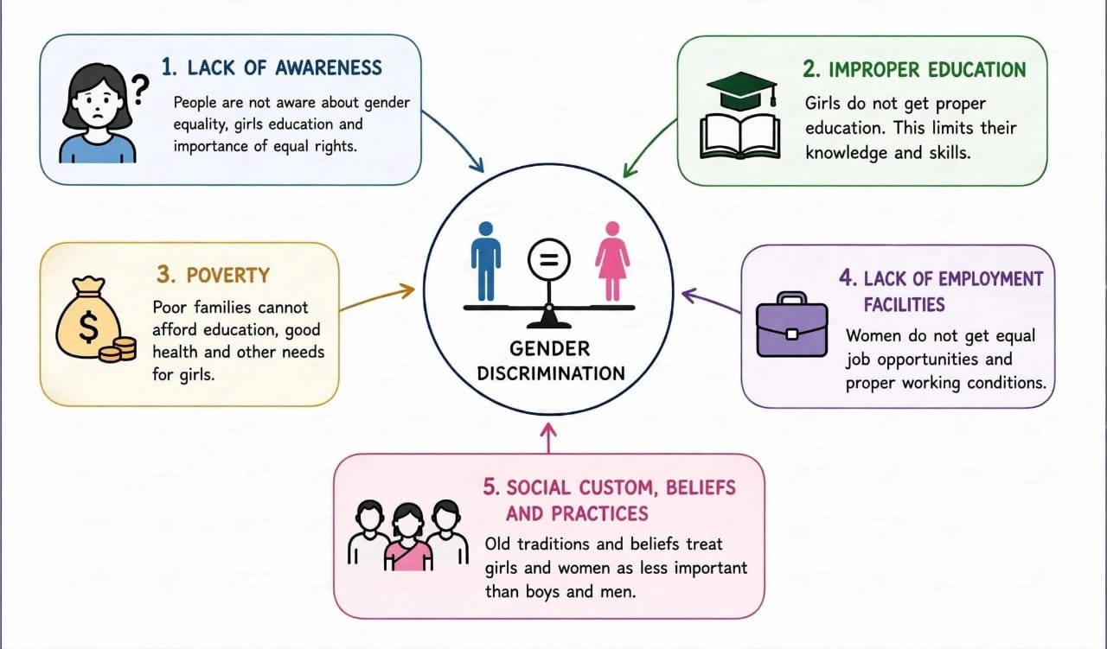
Causes of gender discrimination

Slide 4
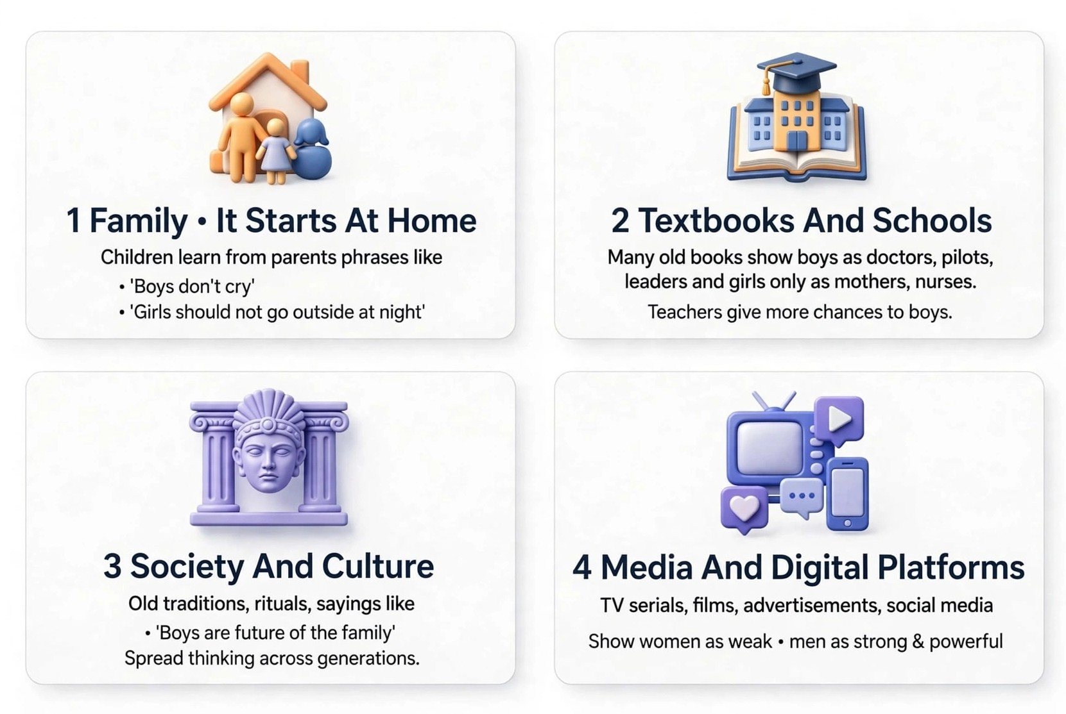
How Gender Discrimination Spreads

Slide 5
Gender Discrimination In The Construction Of Knowledge
Male-dominated knowledge production
Gender bias in research
Ignoring women's contributions
Unequal opportunities
Lack of diverse perspectives

Slide 6
Gender Discrimination in the Dissemination of Knowledge
Unequal Access to Education
Digital Gender Divide
Low Visibility of women's work
Limited voice
Gender stereotypes

Slide 7
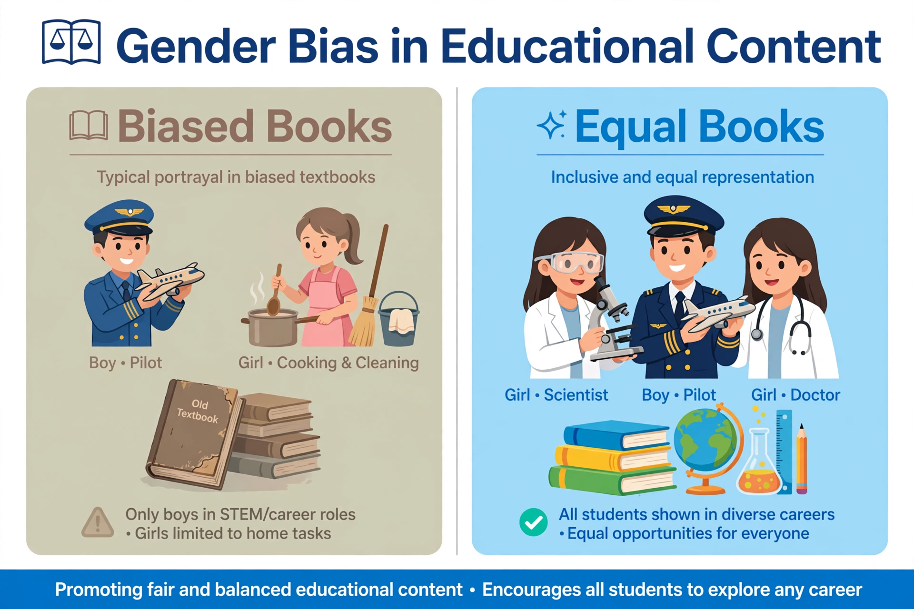
Gender Bias In Educational Content
Unequal treatment based on gender in books, teaching and subject choice. In schools, boys and girls are not treated equally in books and classes
Schools have lack of good facilities for girls like clean toilets, safe transport, and hostel, so girls drop out early
Gender Bias causes girls to dropout school/college early and that's the reason they get less career options
This can be fixed by making equal books, schemes like “Beti Bachao Beti Padhao” and new education policy 2020 reforms
Fig: Gender Biasness

Slide 8
Impact Of Gender Discrimination In History & Present
Past Impact
No Education: Girls Were Not Allowed To Go To School
No Property Right: Women Had No Right To Father's Property Or Job
Knowledge Was One-sided: Only Men's Ideas Were Written In Books. Women's History Was Ignored
Social Pressure: Women Could Not Speak In Public. Their Role Was Only Kitchen And Kids
Present Impact
Less Education: Girls Go To School Now, But Dropout Rate Is Still High. Only 32% Girls Have Smartphones For Online Study
Less Salary: Women Do Same Work But Get 20-30% Less Salary Than Men
Knowledge is Still One-Sided: Now books are written, but online knowledge, YouTube, Wikipedia - 90% creators are still men. So girls get less digital guidance
Mental Pressure: Women Have To Manage Both Job + Home. Also, Face Harassment At Workplace

Slide 9
Importance Of Gender Education
Shows The Real Truth: Gender Education Shows Us How Women's Knowledge Was Hidden In History. We Get To Know The Real Truth
Makes Education Equal: If We Know This Discrimination, We Can Make Books, Syllabus, And School Equal For Both Boys And Girls
Gives Voice To Women: It Gives Chance To Women Writers, Scientists, And Teachers To Share Their Ideas. Knowledge Becomes Complete
Breaks Bias In Classroom: Teachers Will Understand They Should Not Give More Chance To Boys Only In Questions, Lab, Or Leadership
Helps NEP 2020 Goal: NEP 2020 Says Inclusive Education. This Topic Directly Supports That Goal - Education For All, Without Gender Bias

Slide 10
Measure To Reduce Gender Discrimination
Change in Textbooks: Add more women writers, scientists and freedom fighters in books. Girls can see role models
Equal Chance in Classroom: Teacher should give equal chance to both. Boys and girls both will answer, both will lead, both will clean board
Girls Friendly School: Make separate toilets, free sanitary pads, and safe transport. So, girl's dropout rate will decrease
Training for Teachers: Teachers should be trained not to say "Boys are strong in math's". Stop such bias talk
Use of Technology: Give same mobile, internet and career guidance to girls. Make WhatsApp groups for girl's career counselling

Slide 11
Summary
Gender discrimination is created by society
Old knowledge was made only by men, so women's views were missing
It spreads through books, schools and media
It harms girls' education and growth
Gender education and equal opportunity can remove it and bring equality
Conclusion
Equality is not just giving same chance, it is giving respect to both genders. We should promote gender equality, fair representation, and gender-sensitive education to build a more inclusive and just society.

Slide 12
THANK
YOU

